Slide 1
Multi-Finger Gestural Interaction with 3D Volumetric Displays
Tovi Grossman
Daniel Wigdor
Ravin Balakrishnan
Presented at UIST2004, Santa Fe, NM, USA

Slide 2
Volumetric Displays
Points illuminated in true 3D
360° viewing angle
Available commercially

Slide 3
Volumetric Displays

Slide 4
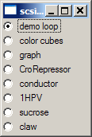
Current Use
Non-interactive output-only

Slide 5
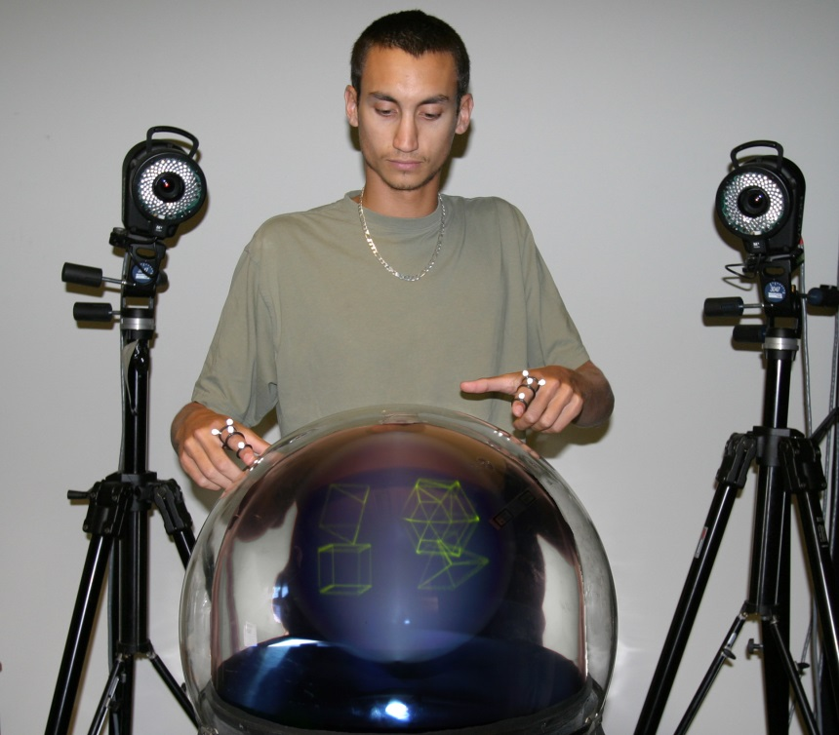
Motivation
Understand surrounding issues
Develop appropriate interaction techniques
Menus and widgets
Object Selection
Transformations

Slide 6
Previous Work
Balakrishnan, Fitzmaurice, Kurtenbach (2001)
Discusses possible interaction scenarios
Mock-up prototypes
Balakrishnan, Fitzmaurice, & Kurtenbach. IEEE Computer 2001

Slide 7
Previous Work
Balakrishnan et al (2001)
Discusses possible interaction scenarios
Mock-up prototypes
Much VR Research
3D Selection
3D Object Manipulation
3D Widgets

Slide 8
Unique Issues
Objects within arm’s reach
Objects inside enclosure
Direct link between input and display

Slide 9
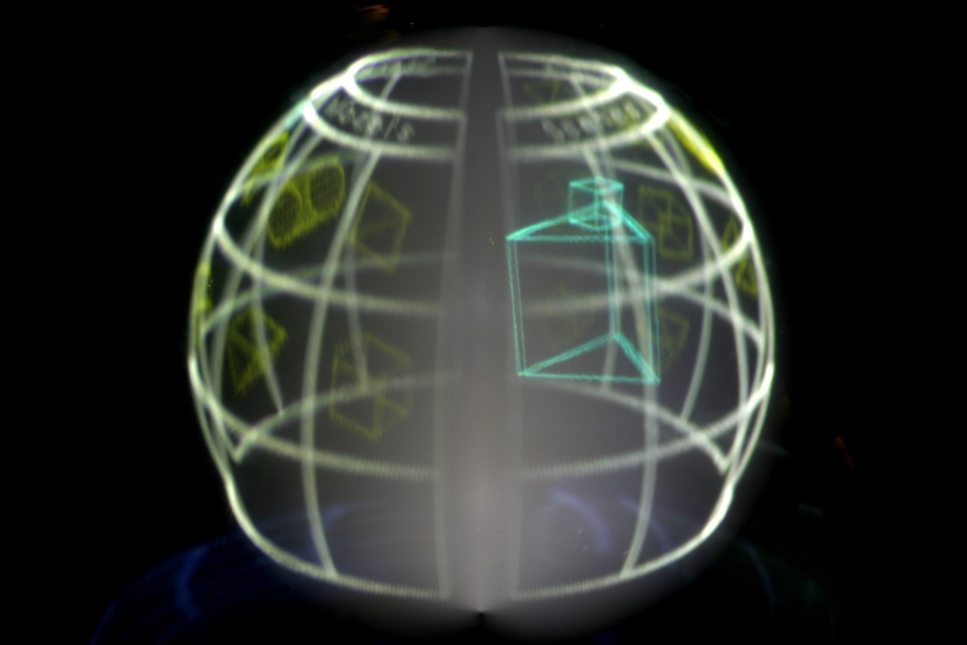
Design Principles
Volumetric Display as exclusive platform

Slide 10
Design Principles
Multi-Viewpoint Operation
Out-of-Viewpoint Operation
Direct Touch and Gestural Input

Slide 12
Implementation - Display
Perspecta Spatial 3D System
10" spherical image
198 2D slices, 768x768 each
24Hz refresh rate

Slide 13
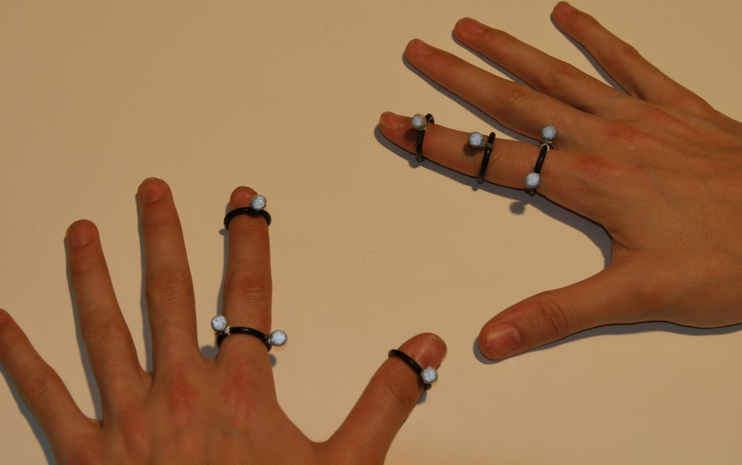
Implementation – Finger Tracking
Vicon motion tracking system
5 Cameras
Tracked 5mm markers
Real Time, 120Hz, sub mm precision

Slide 14
Implementation – Finger Tracking
Detect away, hover, and touch

Slide 15
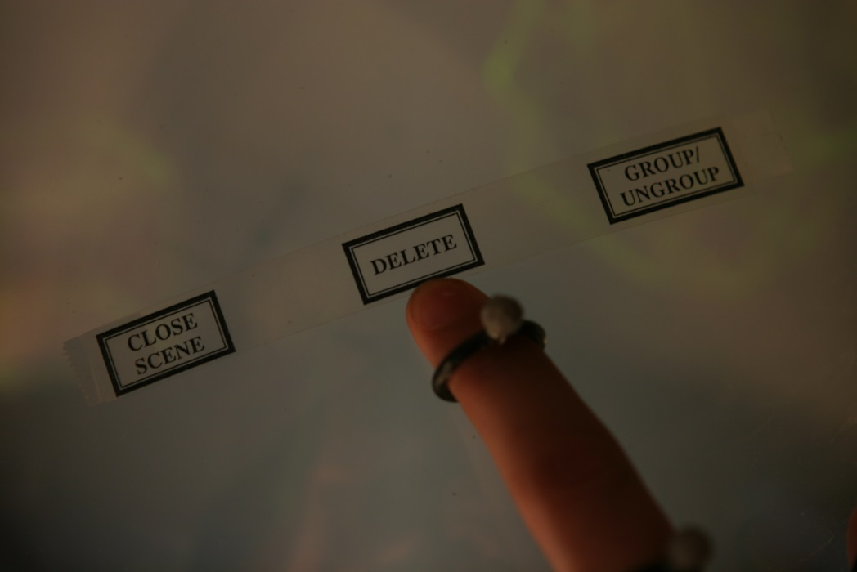
Command Input
Surface Menus
On outside surface of display
Tap to enter command
Hold to maintain mode

Slide 16
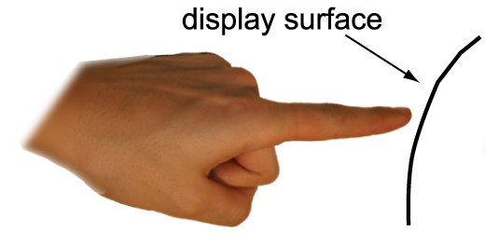
Command Input
Postures and Gestures
Point

Slide 17
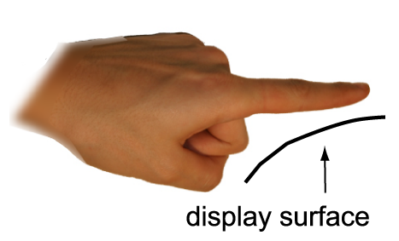
Command Input
Postures and Gestures
Point
Flat

Slide 18
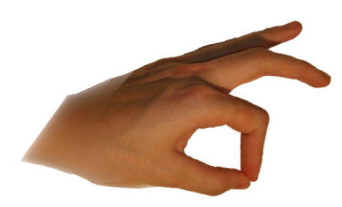
Command Input
Postures and Gestures
Point
Flat
Pinch

Slide 19
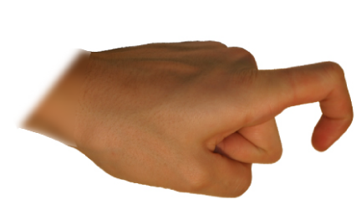
Command Input
Postures and Gestures
Point
Flat
Pinch
Curl

Slide 20
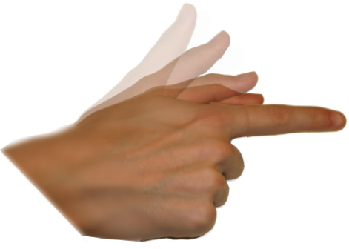
Command Input
Postures and Gestures
Point
Flat
Pinch
Curl
Trigger

Slide 21
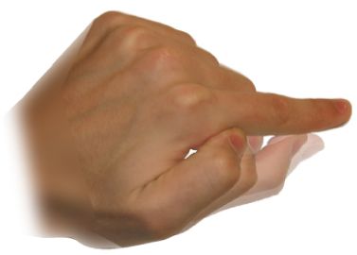
Command Input
Postures and Gestures
Point
Flat
Pinch
Curl
Trigger
Scrub

Slide 22
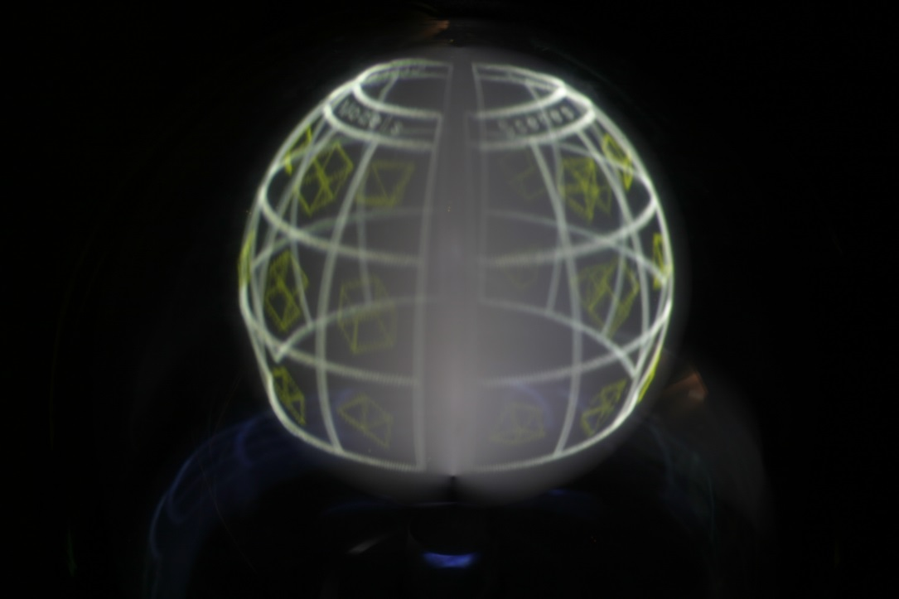
Interaction Techniques
Surface Browser
Used for object previews, organization
File browser

Slide 23
Surface Browser

Slide 24
Interaction Techniques
Transformations
Widgets for visual feedback
Colour to indicate active
Rotate | Translate | Scale
touch & drag | pinch & scrub | bimanual drag

Slide 25
Transformations

Slide 26
Interaction Techniques
Constrained Transformations

Slide 27
Interaction Techniques
Adding Models
Surface browser allows maintained context

Slide 28
Interaction Techniques
Selection: Ray cursor with depth control

Slide 29
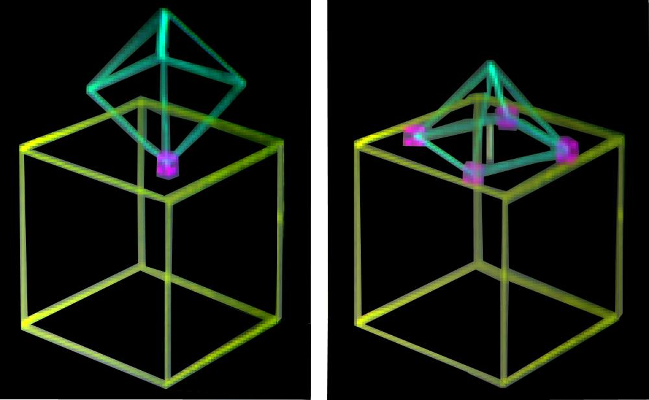
Interaction Techniques
Object Snapping
Menu activated
Objects snap to faces, edges

Slide 30
Object Snapping

Slide 31
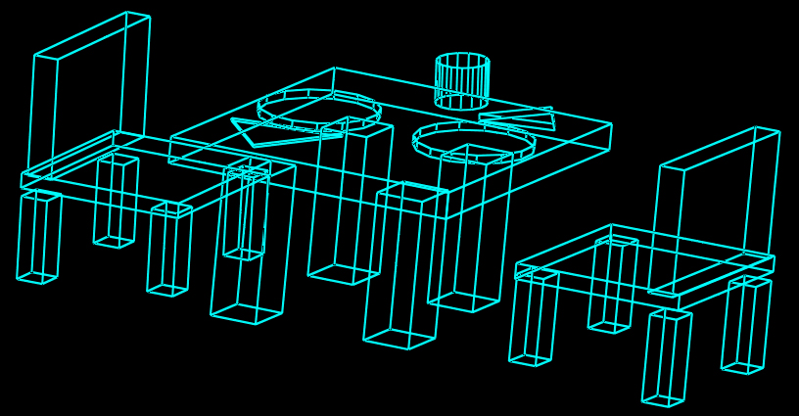
Contributions
Identified issues unique to domain
True 3D
Enclosed Space
Within-reach
Provided generalizable techniques
Menus and widgets
Object Selection
Transformations
Implementation

Slide 32
Acknowledgements
Actuality Systems
DGP Lab and members
John Hancock

Slide 33
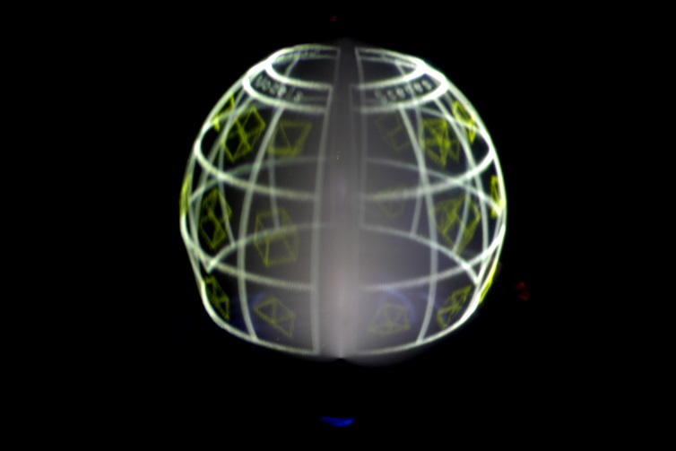
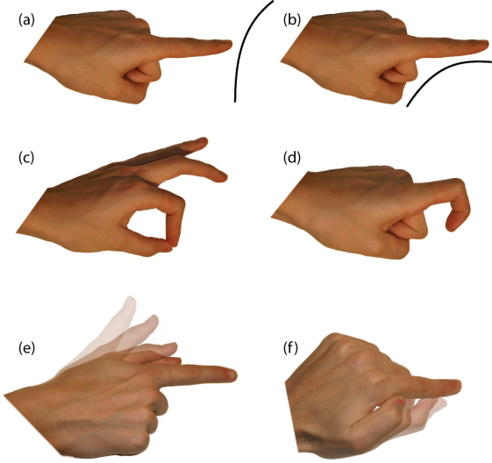
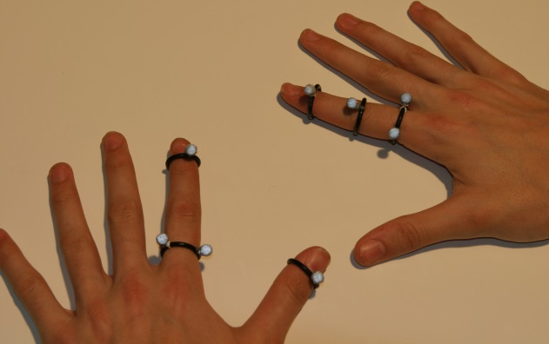
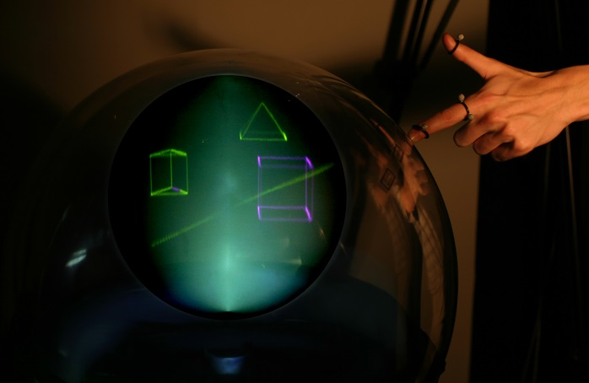
Questions?

