Slide 1
Under the Table Interaction
Presented at UIST2006, October, 2006
Daniel Wigdor
Darren Leigh
Clifton Forlines
Samuel Shipman
John Barnwell
Ravin Balakrishnan
Chia Shen
Notes:
introduce
paper title
Co-authors
MERL & DGP
Brief summary richness in paper (though ugly without colour)

Slide 3
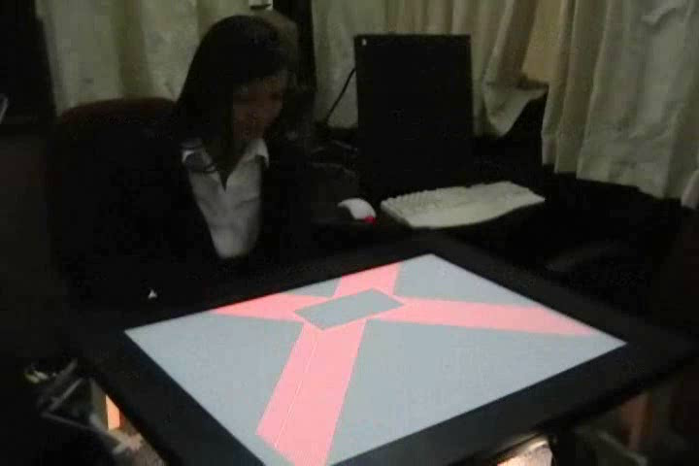

Slide 5
Why Go Under the Table?
Address issues with existing digital tabletops
Afford new interaction paradigms

Slide 6
Related Work: Two-Sided Input
BehindTouch (Tomimatsu) 2003
HybridTouch (Sugimoto & Hiroki) 2006

Slide 7
Under the Table Interaction
Inverted Table
Two Sided Table

Slide 8
Under the Table Interaction
Inverted Table
Two Sided Table
Notes:
We’ll talk about this one first, then the next. Note that all that apply to the first apply to the second.

Slide 9
Direct Touch Input*

Slide 10
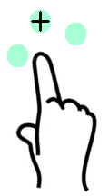
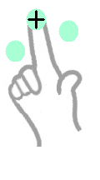
Targeting Accuracy
Under the Table
Lift-off
-Potter et al. (1988)
Regular touchtable

Slide 11
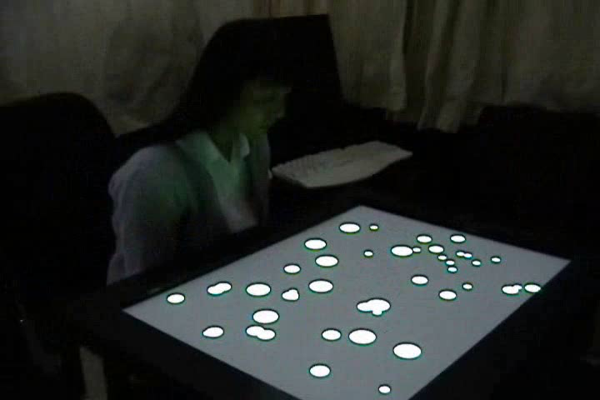
Targeting Accuracy

Slide 12
Targeting Accuracy

Slide 13
Different Bimanual Posture

Slide 14
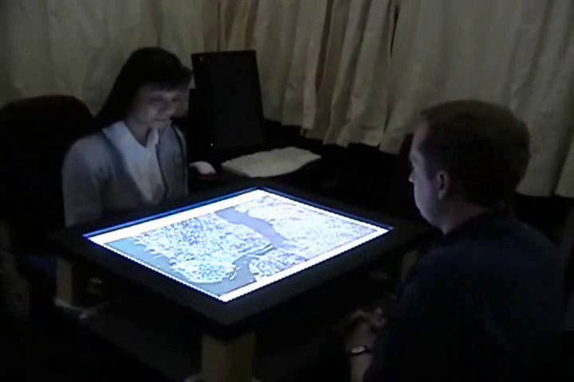
Accidental Touching Less Likely

Slide 15
Accidental Touching Less Likely

Slide 16
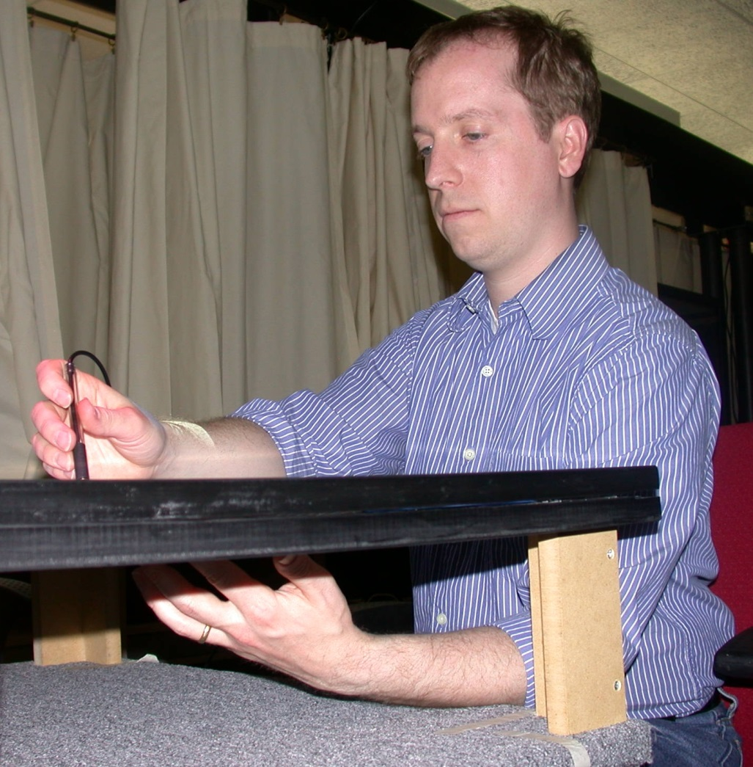
Arm Fatigue

Slide 17
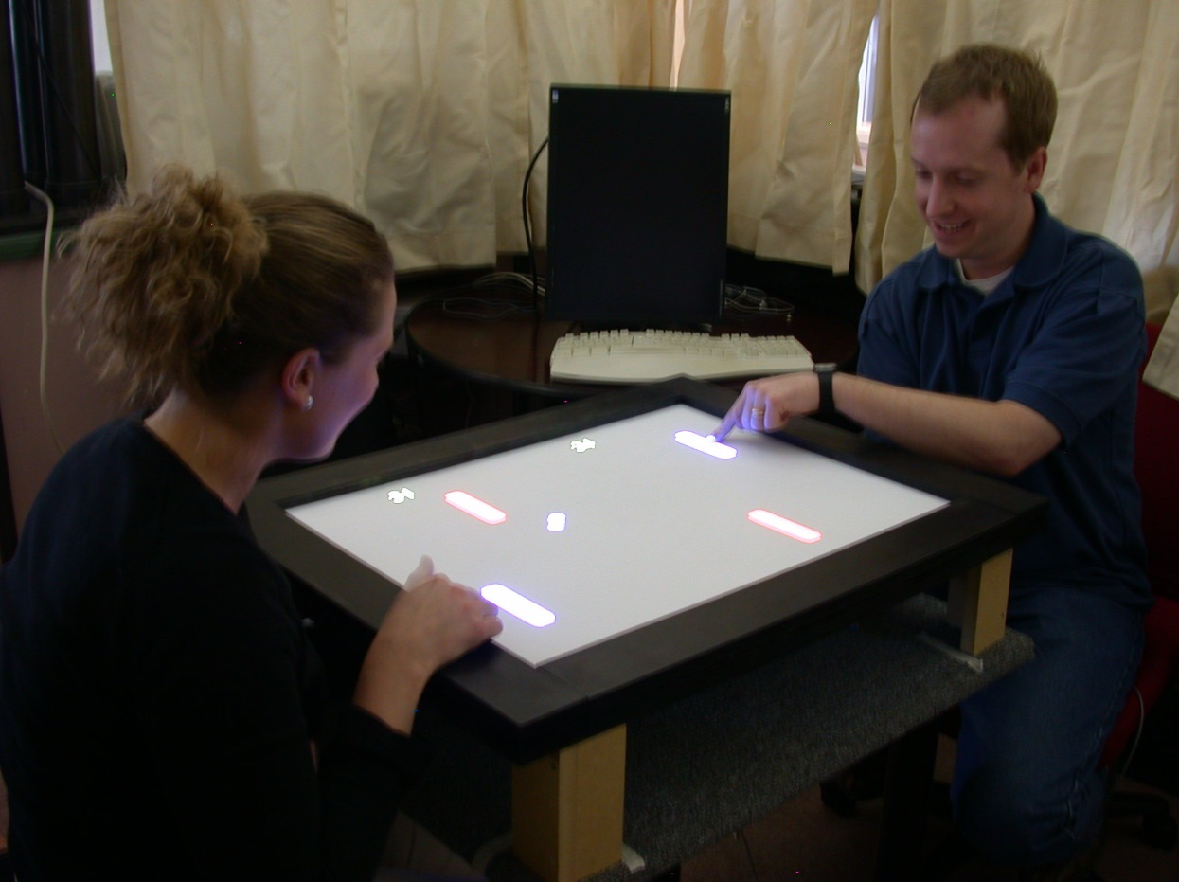
Other Issues and Affordances
Reduced reach
Reduced occlusion
Input privacy

Slide 18
Under the Table Interaction
Inverted Table
Two Sided Table
Notes:
Done talking about this one now… next….

Slide 19
Under the Table Interaction
Inverted Table
Two Sided Table
Notes:
What happens when we add a second surface?

Slide 20
Hand Location Semantics

Slide 21
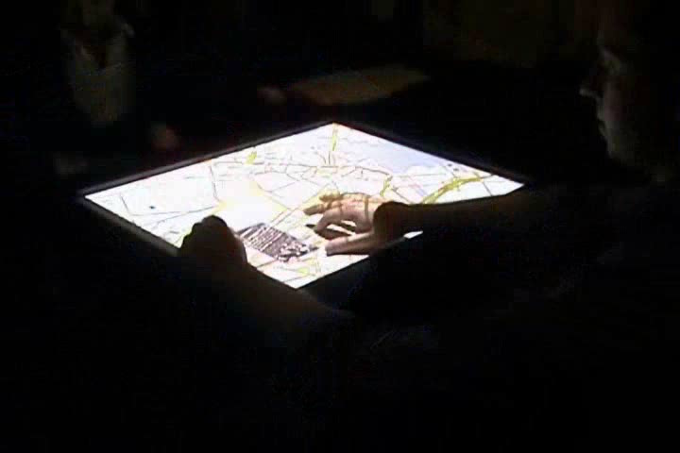
Modal Coupling with Sides

Slide 22
Modal Coupling with Sides

Slide 23
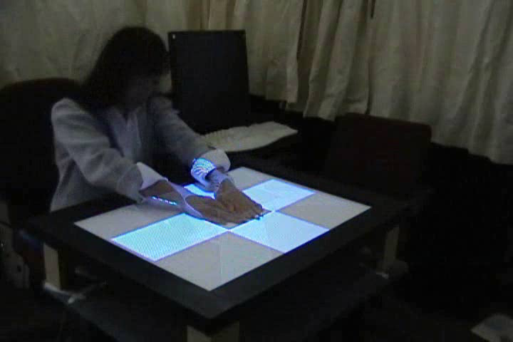
Co-locality of Bimanual Input

Slide 24
Co-locality of Bimanual Input

Slide 25
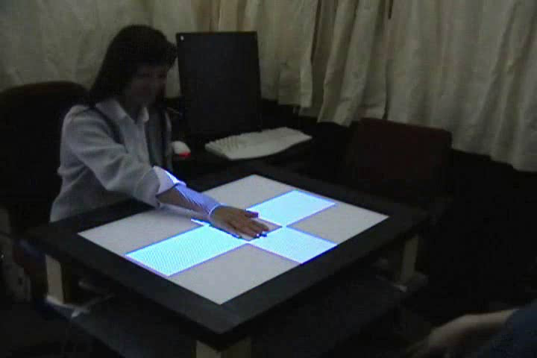
Co-locality of Multi-User Input

Slide 26
Co-locality of Multi-User Input

Slide 27
New Bimanual Symmetry

Slide 28
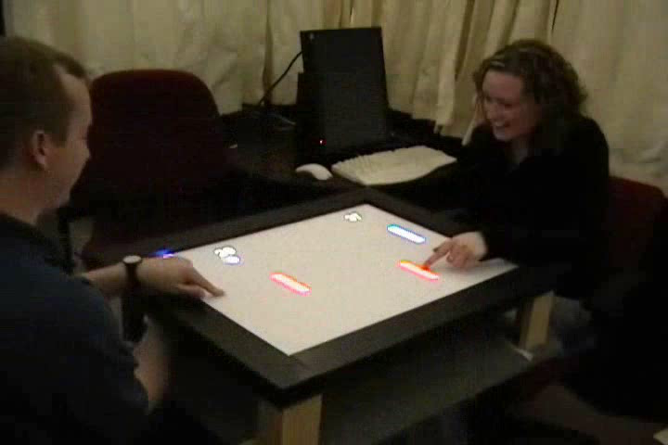
Reduced Physical Interference

Slide 29
Reduced Physical Interference

Slide 30
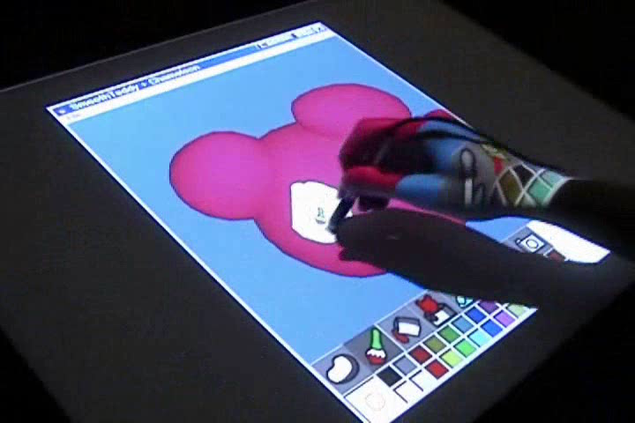
3D Space

Slide 31
3D Space

Slide 32
Alternative Input Mapping

Slide 33
Under the Table Interaction
Inverted Table
Two Sided Table
Notes:
What happens when we add a second surface?

Slide 34
Under the Table Interaction
Inverted Table
Two Sided Table
Notes:
What happens when we add a second surface?

Slide 35
Blind Pointing Accuracy
Experiment Task: Land-on target

Slide 36
Blind Pointing Accuracy
Experiment Task: Land-on target
Design:
  8 participants x
  2 sides of table x
  3 target sizes (1cm, 2cm, 3cm) x
  3 target distances (6cm, 12cm, 18cm) x
  60 selections
  = 8640 Total selections

Slide 37
Blind Pointing Accuracy: Results (Error Rate)

Slide 38
Blind Pointing Accuracy: Results (Error Rate)

Slide 39
Blind Pointing Accuracy: Results (Error Rate)
 |  | Table-top |  |  | Table-bottom

Slide 40
Blind Pointing Accuracy: Results (Error Rate)
 |  | Target Distance
 |  | 6 cm | 12cm | 18cm | 6cm | 12cm | 18cm
 |  | Table-top |  |  | Table-bottom

Slide 41
Blind Pointing Accuracy: Results (Error Rate)
 |  | Target Distance
 |  | 6 cm | 12cm | 18cm | 6cm | 12cm | 18cm
Target Size | 1cm
 | 2cm
 | 3cm
 |  | Table-top |  |  | Table-bottom

Slide 42
Blind Pointing Accuracy: Results (Error Rate)
 |  | Target Distance
 |  | 6 cm | 12cm | 18cm | 6cm | 12cm | 18cm
Target Size | 1cm | 14% | 10% | 12%
 | 2cm | 1% | 1% | 1%
 | 3cm | 1% | 1% | 1%
 |  | Table-top |  |  | Table-bottom

Slide 43
Blind Pointing Accuracy: Results (Error Rate)
 |  | Target Distance
 |  | 6 cm | 12cm | 18cm | 6cm | 12cm | 18cm
Target Size | 1cm | 14% | 10% | 12% | 66% | 77% | 78%
 | 2cm | 1% | 1% | 1% | 30% | 43% | 43%
 | 3cm | 1% | 1% | 1% | 12% | 17% | 22%
 |  | Table-top |  |  | Table-bottom

Slide 44
Results: Accuracy (mean error distance, cm)

Slide 45
Results: Accuracy (mean error distance, cm)
 |  | Target Distance
 |  | 6cm | 12cm | 18cm | 6cm | 12cm | 18cm
Target Size | 1cm
 | 2cm
 | 3cm
 |  | Table-top |  |  | Table-bottom

Slide 46
Results: Accuracy (mean error distance, cm)
 |  | Target Distance
 |  | 6cm | 12cm | 18cm | 6cm | 12cm | 18cm
Target Size | 1cm | 0.02 | 0.02 | 0.03
 | 2cm | 0.00 | 0.00 | 0.00
 | 3cm | 0.00 | 0.00 | 0.00
 |  | Table-top |  |  | Table-bottom

Slide 47
Results: Accuracy (mean error distance, cm)
 |  | Target Distance
 |  | 6cm | 12cm | 18cm | 6cm | 12cm | 18cm
Target Size | 1cm | 0.02 | 0.02 | 0.03 | 0.40 | 0.58 | 0.67
 | 2cm | 0.00 | 0.00 | 0.00 | 0.20 | 0.24 | 0.30
 | 3cm | 0.00 | 0.00 | 0.00 | 0.10 | 0.10 | 0.12
 |  | Table-top |  |  | Table-bottom

Slide 48
Experimental Conclusions
Direct touch input paradigm maintained
Don’t build systems that rely on land-on accuracy

Slide 49
Summary
Under the Table: inverted and two-sided
New affordances and fixes
Interesting platform

Slide 50
Acknowledgements
Jacquelyn Martino
Mike Wu
Takeo Igarashi
William Yerazunis
Paul Dietz
Other MERL colleagues
Experiment participants

Slide 51
Questions?
Inverted Table
Two Sided Table

Slide 52
Bottom Side Touches:
Direct touch input*
Arm fatigue
Reduced reach
Reduced occlusion
Input privacy
Different bimanual posture
Fewer accidental touches
Improved accuracy!
Notes:
*: can break a little bit if you want, all depends on visual feedback

Slide 53
Two-Sided Table Touches:
Hand location semantics
Side/modal coupling
Bimanual co-location
Multi-user co-location
New bimanual symmetry
Reduced interference
3D space affordance
Alternative input mapping

