Slide 1
Exploring and Reducing the Effects of Orientation on Text Readability in Volumetric Displays
Tovi Grossman
Daniel Wigdor
Ravin Balakrishnan

Slide 2
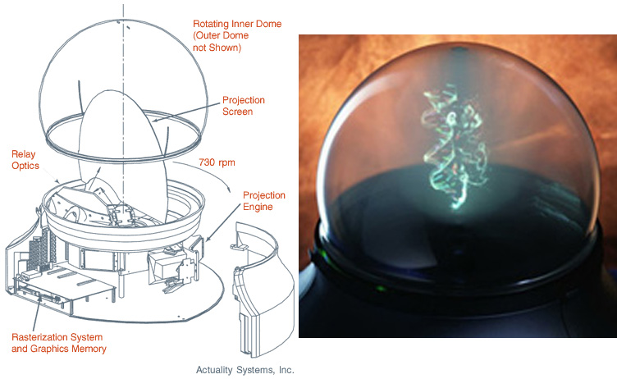
Volumetric Displays
Notes:
New display plattform
True 3d
Can revolutionize
-3 scenarios
First need solid understanding of sorrounding human factors

Slide 3
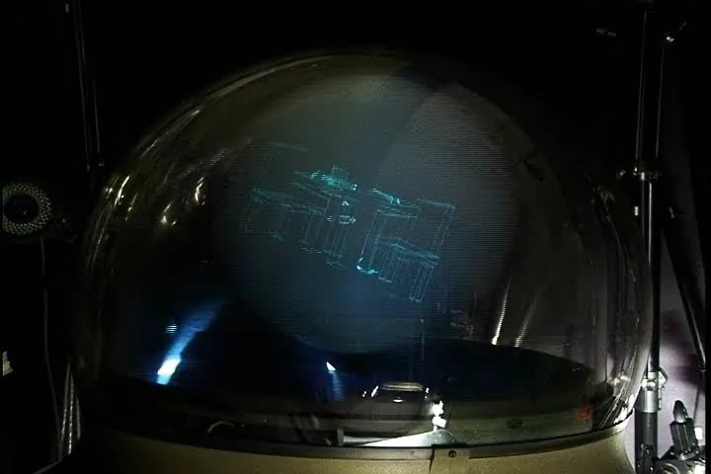
Volumetric Displays
Notes:
Here is a smaple, camera moving
Live demo!!

Slide 4
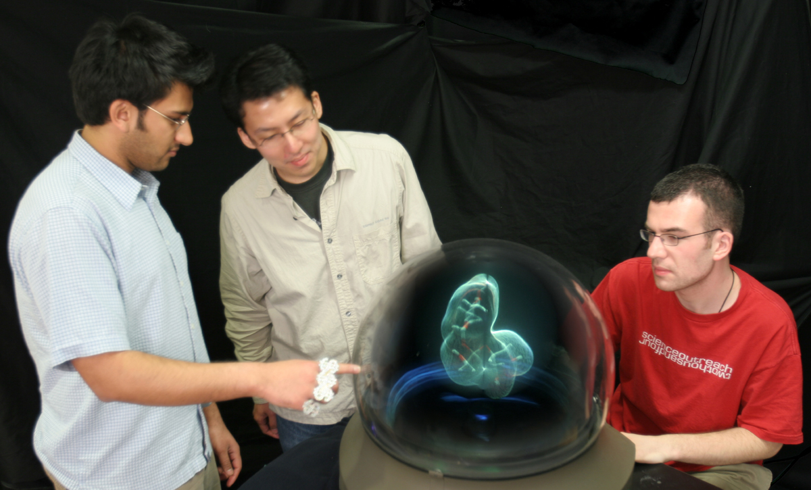
360° Viewing
Notes:
Note 360 degree viewing
Perfect for collaborative use

Slide 5
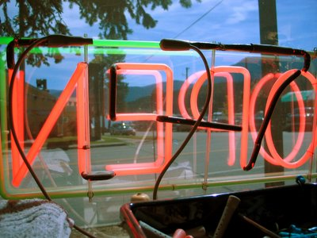
Reading Text
Notes:
But presenting text is a challenge

Slide 6
Our Goals
How do rotations affect reading?
Can the effects be mitigated?
Can orientation be optimized?

Slide 7
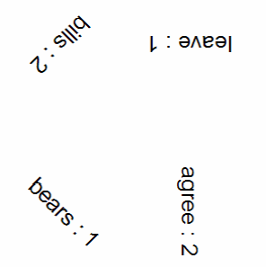
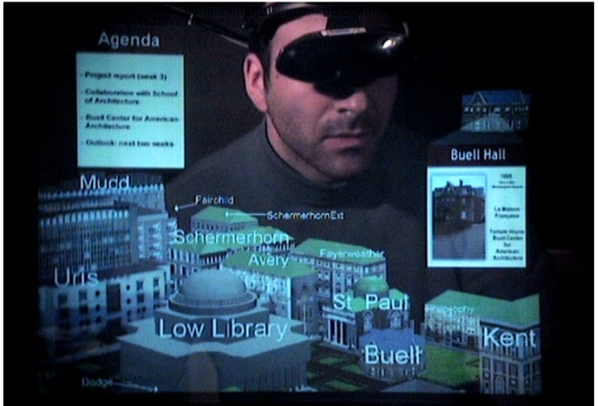
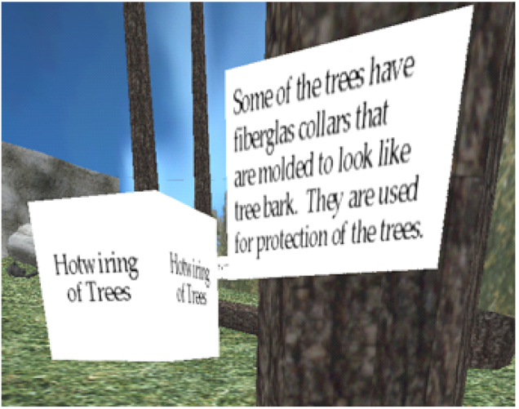
Related Work
Larson et al. CHI 2000.
Wigdor & Balakrishnan. ECSCW 05.
Bell et al. UIST 2001.
Chen et al. VR 2004.
Notes:
Bell – algorithm forspatial layout descret – either occludes or doesn’t- not true for orientaiton
For our purposes within world layout
so we ant to extend the larson and wigdor studies

Slide 8
Related Work
Balakrishnan, Fitzmaurice, and Kurtenbach. CHI 2000.
Notes:
8
Bell – algorithm forspatial layout descret – either occludes or doesn’t- not true for orientaiton
For our purposes within world layout
so we ant to extend the larson and wigdor studies

Slide 9
Some Examples
Notes:
ahead
among
arena
arise
asian
audio
audit
awful
beard
begun
being
blade
bonds
bonus
bound
bound
brand
bread
broke
buyer
cards
catch
cited
cited
costs
debut
delta
depot
depth
dolly
draft
drops
edged
edged
ended
fault
feels
forms
gates
gauge
guilt
herbs
herbs
input
knows
large
lungs
lying
manor
medal
merit
moral
nylon
ocean
oddly
odour
onion
ought
pages
pains
paper
peers
penal
phase
photo
pipes
plant
plots
pound
pride
pride
prime
prior
proof
proud
queue
queue
quick
quota
quota
ranks
rated
rated
roofs
rugby
sauce
scrap
seals
seize
sober
spare
spine
spots
spray
squad
stamp
stand
stems
stern
stood
sweat
tales
tends
thief
third
tribe
trout
turns
twins
urged
usage
venue
verge

Slide 10
Some Examples
input
Notes:
10
ahead
among
arena
arise
asian
audio
audit
awful
beard
begun
being
blade
bonds
bonus
bound
bound
brand
bread
broke
buyer
cards
catch
cited
cited
costs
debut
delta
depot
depth
dolly
draft
drops
edged
edged
ended
fault
feels
forms
gates
gauge
guilt
herbs
herbs
input
knows
large
lungs
lying
manor
medal
merit
moral
nylon
ocean
oddly
odour
onion
ought
pages
pains
paper
peers
penal
phase
photo
pipes
plant
plots
pound
pride
pride
prime
prior
proof
proud
queue
queue
quick
quota
quota
ranks
rated
rated
roofs
rugby
sauce
scrap
seals
seize
sober
spare
spine
spots
spray
squad
stamp
stand
stems
stern
stood
sweat
tales
tends
thief
third
tribe
trout
turns
twins
urged
usage
venue
verge

Slide 11
Some Examples
input
input
Notes:
11
ahead
among
arena
arise
asian
audio
audit
awful
beard
begun
being
blade
bonds
bonus
bound
bound
brand
bread
broke
buyer
cards
catch
cited
cited
costs
debut
delta
depot
depth
dolly
draft
drops
edged
edged
ended
fault
feels
forms
gates
gauge
guilt
herbs
herbs
input
knows
large
lungs
lying
manor
medal
merit
moral
nylon
ocean
oddly
odour
onion
ought
pages
pains
paper
peers
penal
phase
photo
pipes
plant
plots
pound
pride
pride
prime
prior
proof
proud
queue
queue
quick
quota
quota
ranks
rated
rated
roofs
rugby
sauce
scrap
seals
seize
sober
spare
spine
spots
spray
squad
stamp
stand
stems
stern
stood
sweat
tales
tends
thief
third
tribe
trout
turns
twins
urged
usage
venue
verge

Slide 12
Some Examples
arena
Notes:
12
ahead
among
arena
arise
asian
audio
audit
awful
beard
begun
being
blade
bonds
bonus
bound
bound
brand
bread
broke
buyer
cards
catch
cited
cited
costs
debut
delta
depot
depth
dolly
draft
drops
edged
edged
ended
fault
feels
forms
gates
gauge
guilt
herbs
herbs
input
knows
large
lungs
lying
manor
medal
merit
moral
nylon
ocean
oddly
odour
onion
ought
pages
pains
paper
peers
penal
phase
photo
pipes
plant
plots
pound
pride
pride
prime
prior
proof
proud
queue
queue
quick
quota
quota
ranks
rated
rated
roofs
rugby
sauce
scrap
seals
seize
sober
spare
spine
spots
spray
squad
stamp
stand
stems
stern
stood
sweat
tales
tends
thief
third
tribe
trout
turns
twins
urged
usage
venue
verge

Slide 13
Some Examples
arena
arena
Notes:
13
ahead
among
arena
arise
asian
audio
audit
awful
beard
begun
being
blade
bonds
bonus
bound
bound
brand
bread
broke
buyer
cards
catch
cited
cited
costs
debut
delta
depot
depth
dolly
draft
drops
edged
edged
ended
fault
feels
forms
gates
gauge
guilt
herbs
herbs
input
knows
large
lungs
lying
manor
medal
merit
moral
nylon
ocean
oddly
odour
onion
ought
pages
pains
paper
peers
penal
phase
photo
pipes
plant
plots
pound
pride
pride
prime
prior
proof
proud
queue
queue
quick
quota
quota
ranks
rated
rated
roofs
rugby
sauce
scrap
seals
seize
sober
spare
spine
spots
spray
squad
stamp
stand
stems
stern
stood
sweat
tales
tends
thief
third
tribe
trout
turns
twins
urged
usage
venue
verge

Slide 14
Some Examples
paper
Notes:
14
ahead
among
arena
arise
asian
audio
audit
awful
beard
begun
being
blade
bonds
bonus
bound
bound
brand
bread
broke
buyer
cards
catch
cited
cited
costs
debut
delta
depot
depth
dolly
draft
drops
edged
edged
ended
fault
feels
forms
gates
gauge
guilt
herbs
herbs
input
knows
large
lungs
lying
manor
medal
merit
moral
nylon
ocean
oddly
odour
onion
ought
pages
pains
paper
peers
penal
phase
photo
pipes
plant
plots
pound
pride
pride
prime
prior
proof
proud
queue
queue
quick
quota
quota
ranks
rated
rated
roofs
rugby
sauce
scrap
seals
seize
sober
spare
spine
spots
spray
squad
stamp
stand
stems
stern
stood
sweat
tales
tends
thief
third
tribe
trout
turns
twins
urged
usage
venue
verge

Slide 15
Some Examples
paper
paper
Notes:
15
ahead
among
arena
arise
asian
audio
audit
awful
beard
begun
being
blade
bonds
bonus
bound
bound
brand
bread
broke
buyer
cards
catch
cited
cited
costs
debut
delta
depot
depth
dolly
draft
drops
edged
edged
ended
fault
feels
forms
gates
gauge
guilt
herbs
herbs
input
knows
large
lungs
lying
manor
medal
merit
moral
nylon
ocean
oddly
odour
onion
ought
pages
pains
paper
peers
penal
phase
photo
pipes
plant
plots
pound
pride
pride
prime
prior
proof
proud
queue
queue
quick
quota
quota
ranks
rated
rated
roofs
rugby
sauce
scrap
seals
seize
sober
spare
spine
spots
spray
squad
stamp
stand
stems
stern
stood
sweat
tales
tends
thief
third
tribe
trout
turns
twins
urged
usage
venue
verge

Slide 16
Some Examples
quota
Notes:
16
ahead
among
arena
arise
asian
audio
audit
awful
beard
begun
being
blade
bonds
bonus
bound
bound
brand
bread
broke
buyer
cards
catch
cited
cited
costs
debut
delta
depot
depth
dolly
draft
drops
edged
edged
ended
fault
feels
forms
gates
gauge
guilt
herbs
herbs
input
knows
large
lungs
lying
manor
medal
merit
moral
nylon
ocean
oddly
odour
onion
ought
pages
pains
paper
peers
penal
phase
photo
pipes
plant
plots
pound
pride
pride
prime
prior
proof
proud
queue
queue
quick
quota
quota
ranks
rated
rated
roofs
rugby
sauce
scrap
seals
seize
sober
spare
spine
spots
spray
squad
stamp
stand
stems
stern
stood
sweat
tales
tends
thief
third
tribe
trout
turns
twins
urged
usage
venue
verge

Slide 17
Some Examples
quota
quota
Notes:
17
ahead
among
arena
arise
asian
audio
audit
awful
beard
begun
being
blade
bonds
bonus
bound
bound
brand
bread
broke
buyer
cards
catch
cited
cited
costs
debut
delta
depot
depth
dolly
draft
drops
edged
edged
ended
fault
feels
forms
gates
gauge
guilt
herbs
herbs
input
knows
large
lungs
lying
manor
medal
merit
moral
nylon
ocean
oddly
odour
onion
ought
pages
pains
paper
peers
penal
phase
photo
pipes
plant
plots
pound
pride
pride
prime
prior
proof
proud
queue
queue
quick
quota
quota
ranks
rated
rated
roofs
rugby
sauce
scrap
seals
seize
sober
spare
spine
spots
spray
squad
stamp
stand
stems
stern
stood
sweat
tales
tends
thief
third
tribe
trout
turns
twins
urged
usage
venue
verge

Slide 18
Some Examples
bound
Notes:
18
ahead
among
arena
arise
asian
audio
audit
awful
beard
begun
being
blade
bonds
bonus
bound
bound
brand
bread
broke
buyer
cards
catch
cited
cited
costs
debut
delta
depot
depth
dolly
draft
drops
edged
edged
ended
fault
feels
forms
gates
gauge
guilt
herbs
herbs
input
knows
large
lungs
lying
manor
medal
merit
moral
nylon
ocean
oddly
odour
onion
ought
pages
pains
paper
peers
penal
phase
photo
pipes
plant
plots
pound
pride
pride
prime
prior
proof
proud
queue
queue
quick
quota
quota
ranks
rated
rated
roofs
rugby
sauce
scrap
seals
seize
sober
spare
spine
spots
spray
squad
stamp
stand
stems
stern
stood
sweat
tales
tends
thief
third
tribe
trout
turns
twins
urged
usage
venue
verge

Slide 19
Some Examples
bound
bound
Notes:
19
ahead
among
arena
arise
asian
audio
audit
awful
beard
begun
being
blade
bonds
bonus
bound
bound
brand
bread
broke
buyer
cards
catch
cited
cited
costs
debut
delta
depot
depth
dolly
draft
drops
edged
edged
ended
fault
feels
forms
gates
gauge
guilt
herbs
herbs
input
knows
large
lungs
lying
manor
medal
merit
moral
nylon
ocean
oddly
odour
onion
ought
pages
pains
paper
peers
penal
phase
photo
pipes
plant
plots
pound
pride
pride
prime
prior
proof
proud
queue
queue
quick
quota
quota
ranks
rated
rated
roofs
rugby
sauce
scrap
seals
seize
sober
spare
spine
spots
spray
squad
stamp
stand
stems
stern
stood
sweat
tales
tends
thief
third
tribe
trout
turns
twins
urged
usage
venue
verge

Slide 20
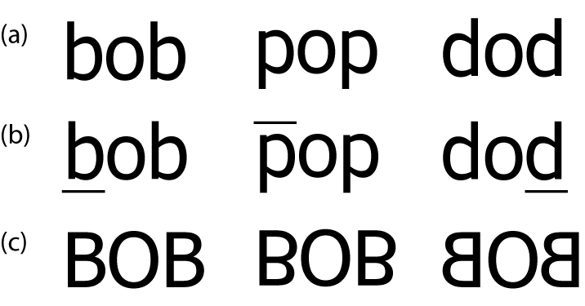
Resolving Ambiguity
Ambiguity at word and character level

Slide 21
Resolving Ambiguity
Ambiguity at word and character level
Disambiguate word (underline)

Slide 22
Resolving Ambiguity
Ambiguity at word and character level
Disambiguate word (underline)
Disambiguate characters (uppercase)

Slide 23
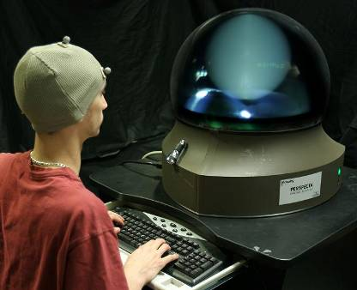
Experiment 1: Effect of Rotation
Tested pitch, yaw, disambiguation

Slide 24
Experiment 1: Design
12 Participants
4 Disambiguation techniques
  None, underline, uppercase, both
2 Rotation Types
  Pitch, yaw
24 angles
  -180 <= θ < 180
  15 degree increments

Slide 25
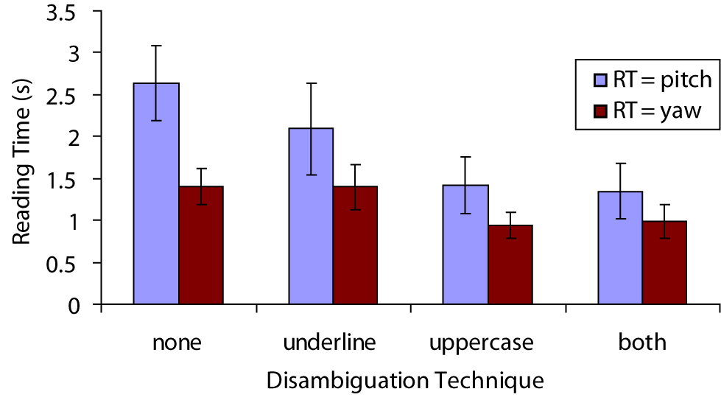
Experiment 1: Results

Slide 26
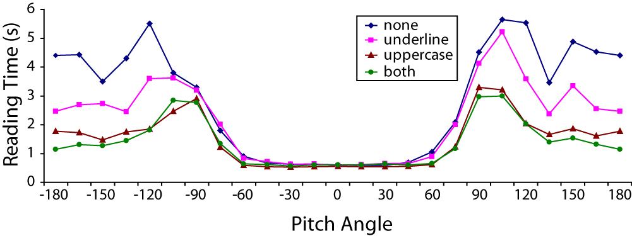
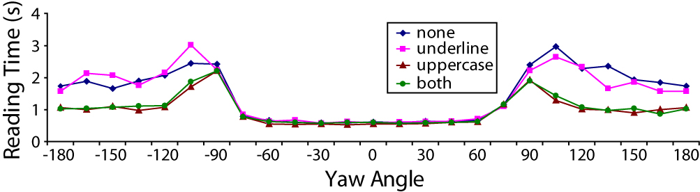
Experiment 1: Results

Slide 27
Orientation Optimization
Optimize orientation for multiple readers

Slide 28
Orientation Optimization
Optimize orientation for multiple readers
Based on user viewpoints
Minimize average reading times

Slide 29
Reading Time Estimates
Pitch(θ)

Slide 30
Reading Time Estimates
Pitch(θ)
Yaw (θ)

Slide 31
Reading Time Estimates
Pitch(θ)
Yaw (θ)
Roll (θ)
Wigdor & Balakrishnan. ECSCW 05.

Slide 32
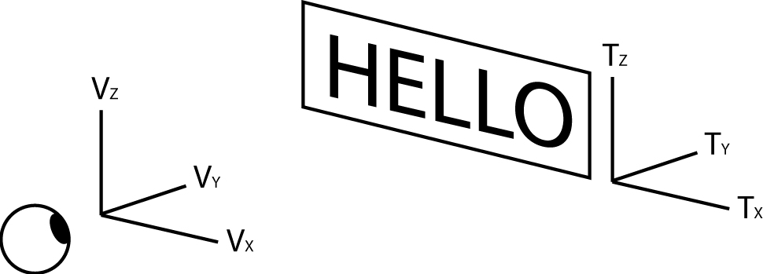
Reading Time Estimates
Interested in V_{k} –T_{k} divergence
  k = {x, y, z}

Slide 33
Reading Time Estimates
For V_{x} –T_{x}
  θ = angle(V_{x}, T_{x})
  L₁ = |proj_{Vy}T_{x}| (yaw)
  L₂ = |proj_{Vz}T_{x}| (roll)

Slide 34
Reading Time Estimates
For V_{x} –T_{x}
  θ = angle(V_{x}, T_{x})
  L₁ = |proj_{Vy}T_{x}| (yaw)
  L₂ = |proj_{Vz}T_{x}| (roll)

Slide 35
Reading Time Estimates
For V_{x} –T_{x}
  θ = angle(V_{x}, T_{x})
  L₁ = |proj_{Vy}T_{x}| (yaw)
  L₂ = |proj_{Vz}T_{x}| (roll)

Slide 36
Optimization Orientation
Start with within world projection
Search pitch, yaw, roll combinations
  Parameter1: Maximum divergence
  Parameter2: Search increment
Use minimum estimate across all users

Slide 37
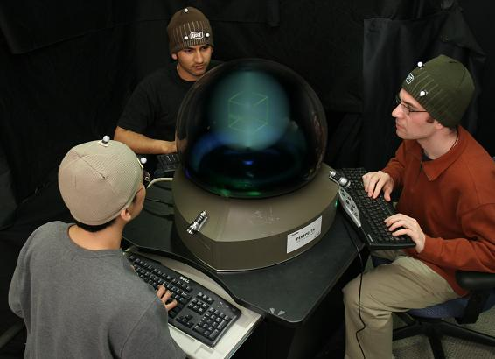
Experiment 2: Group Reading
3 users read labels on a cube

Slide 38
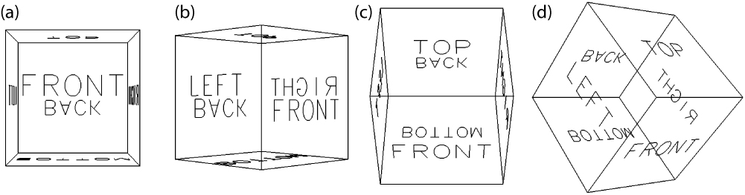
Experiment 2: Design
4 Groups of 3
2 Text layouts
  Naïve, optimized
4 Cube Orientations
6 Faces

Slide 39
Experiment 2: Results
Individual reading times
  Naïve layout: 2.13s
  Optimized layout: 1.42s

Slide 40
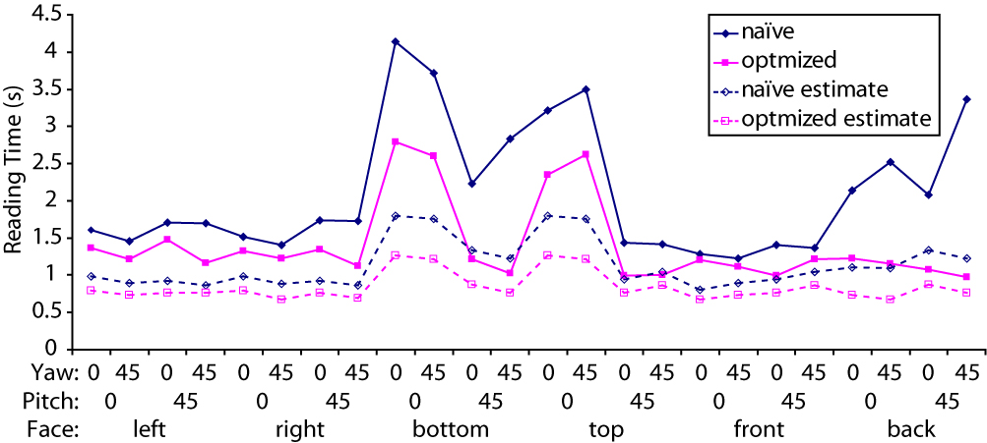
Experiment 2: Results
Group reading times

Slide 41
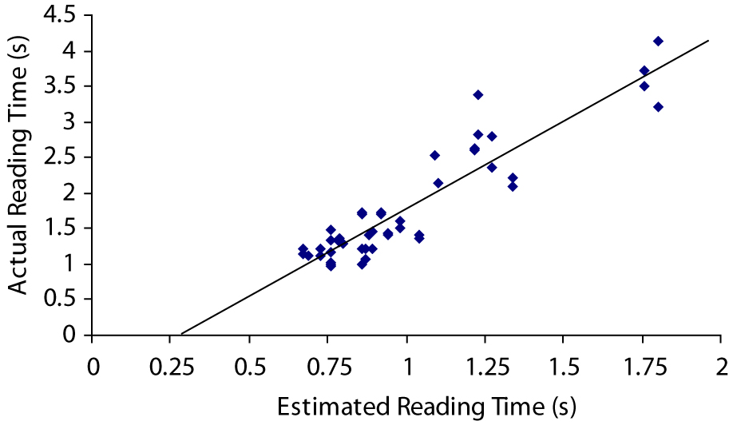
Experiment 2: Results

Slide 42
Summary
Understand effects of 3D orientations
Disambiguation techniques
Data used for orientation optimization
  Reduced reading time 33%
Collaboration on Volumetric Display

Slide 43
Future Work
Optimize weighted average
Combine with spatial layout
Alternative text presentations
Faster algorithm

Slide 44
Acknowledgements
Members of the DGP Lab
John Hancock
Anand Agarawala
Jack Wang
Noah Lockwood
Study participants

Slide 45
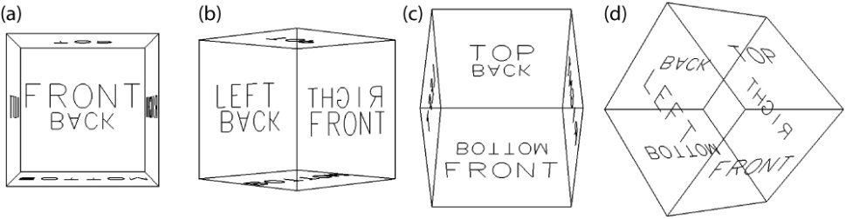
Questions

Slide 46
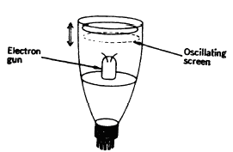
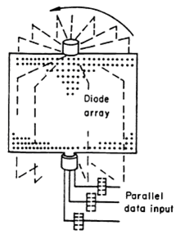
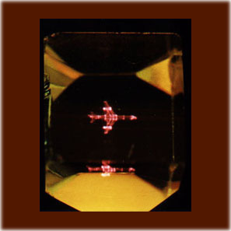
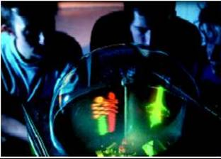
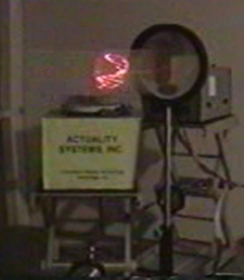
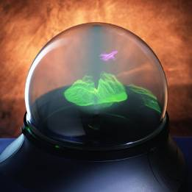
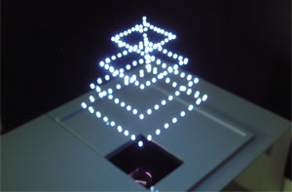
Volumetric Displays

Slide 47
Display Specifications
Perspecta Spatial 3D System
  10" spherical image
  198 2D slices, 768x768 each
  24Hz refresh rate
  3-bit color

Slide 48
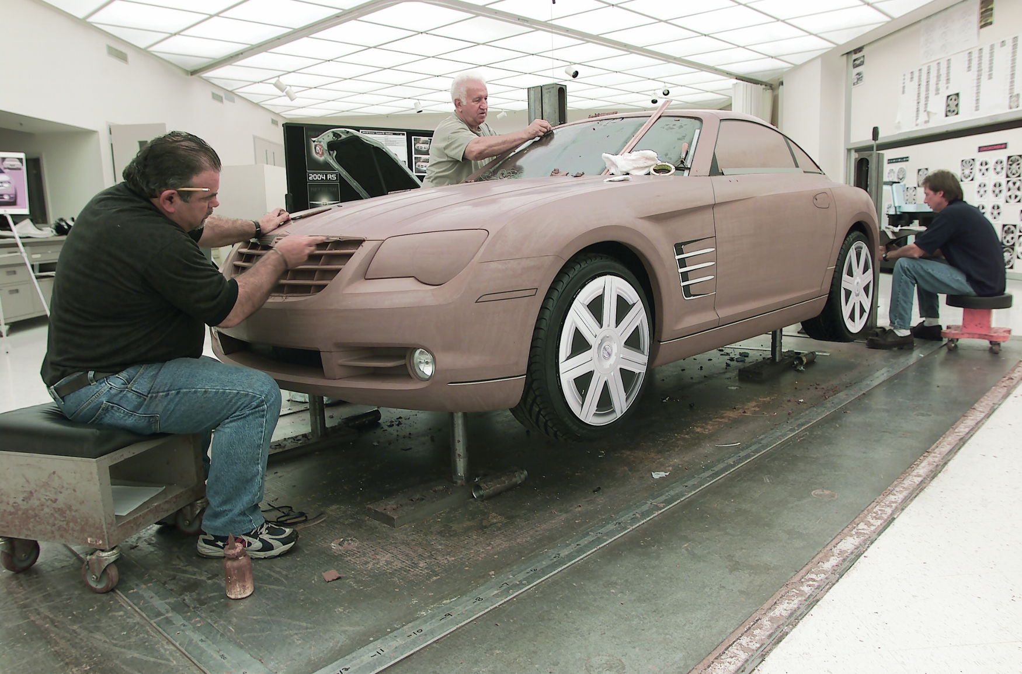

Slide 49
