Slide 1


LucidTouch: A See-Through Mobile Device
Daniel Wigdor
Clifton Forlines
Patrick Baudisch
John Barnwell
Chia Shen

Slide 2
Thank you!
Garrett Winberg & Paul Dietz
Turner Whitted & Darren Leigh
Michael McGuffin & Yuki Mori
Experimental participants

Slide 3
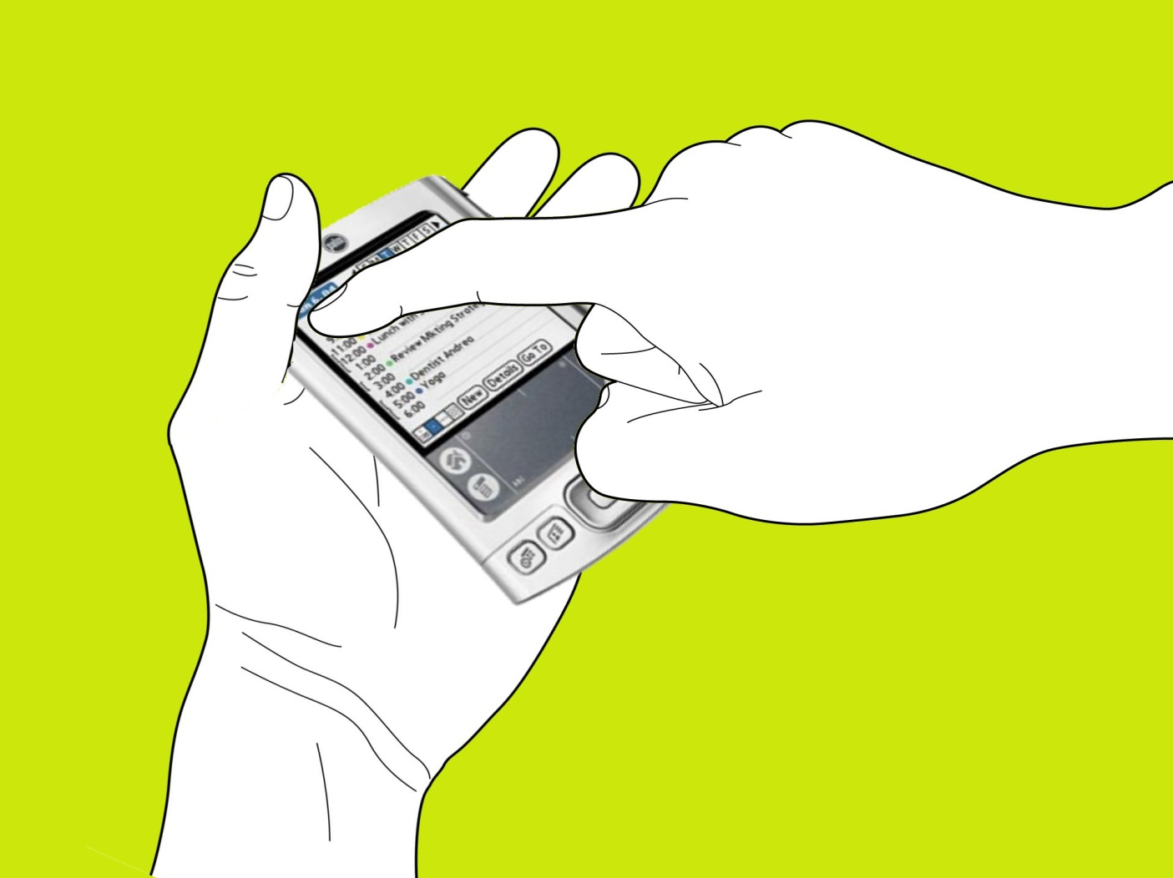
Notes:
2 problems:
- occlusion

Slide 4
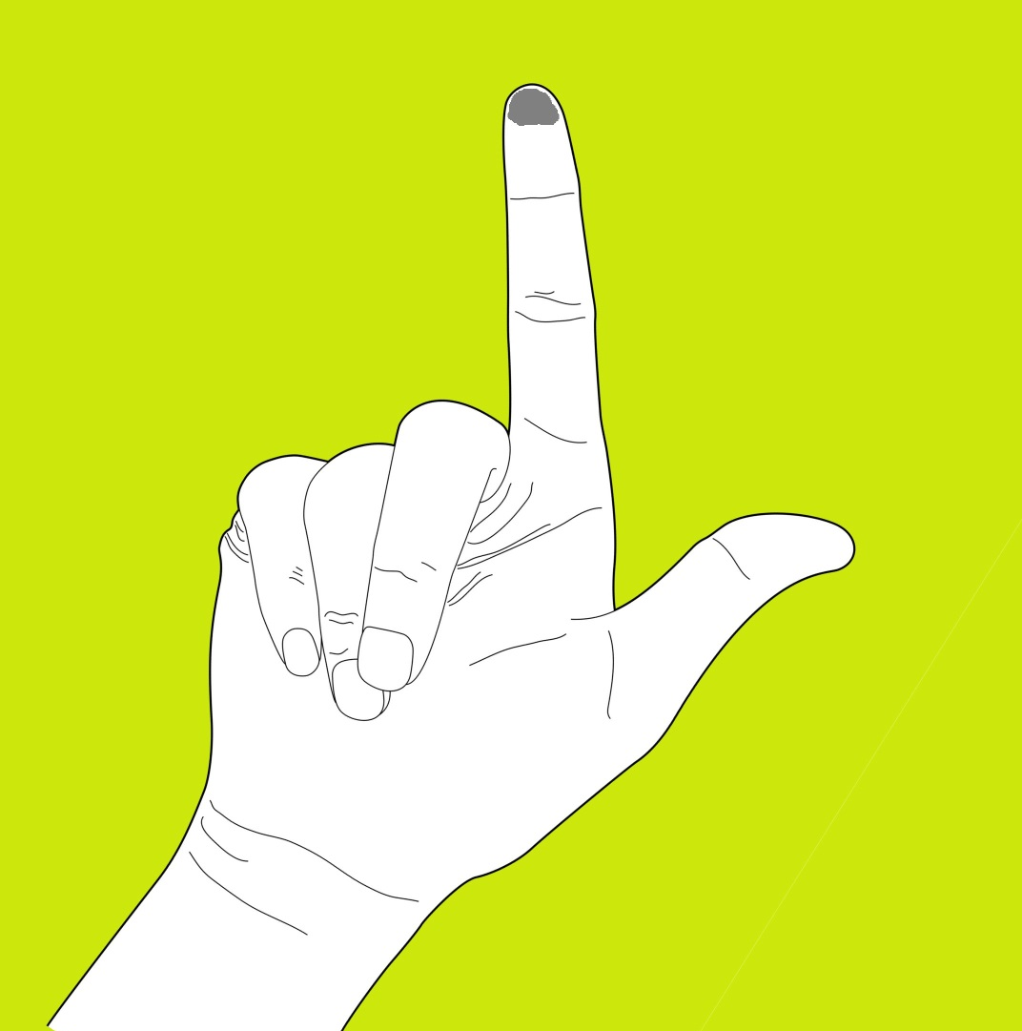

Slide 5
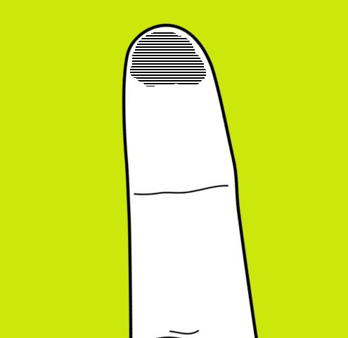
Notes:
Touch area

Slide 6
Offset Cursor (Potter et al. 1988)
Pen
Offset Cursor
Notes:
solutions

Slide 7
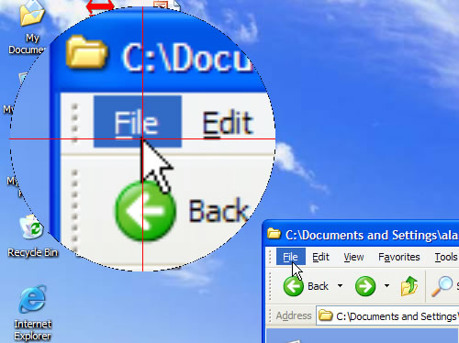
DT Mouse (MERL Commercial Product - 2004)

Slide 8
Shift (Vogel & Baudisch, CHI 2006)

Slide 9
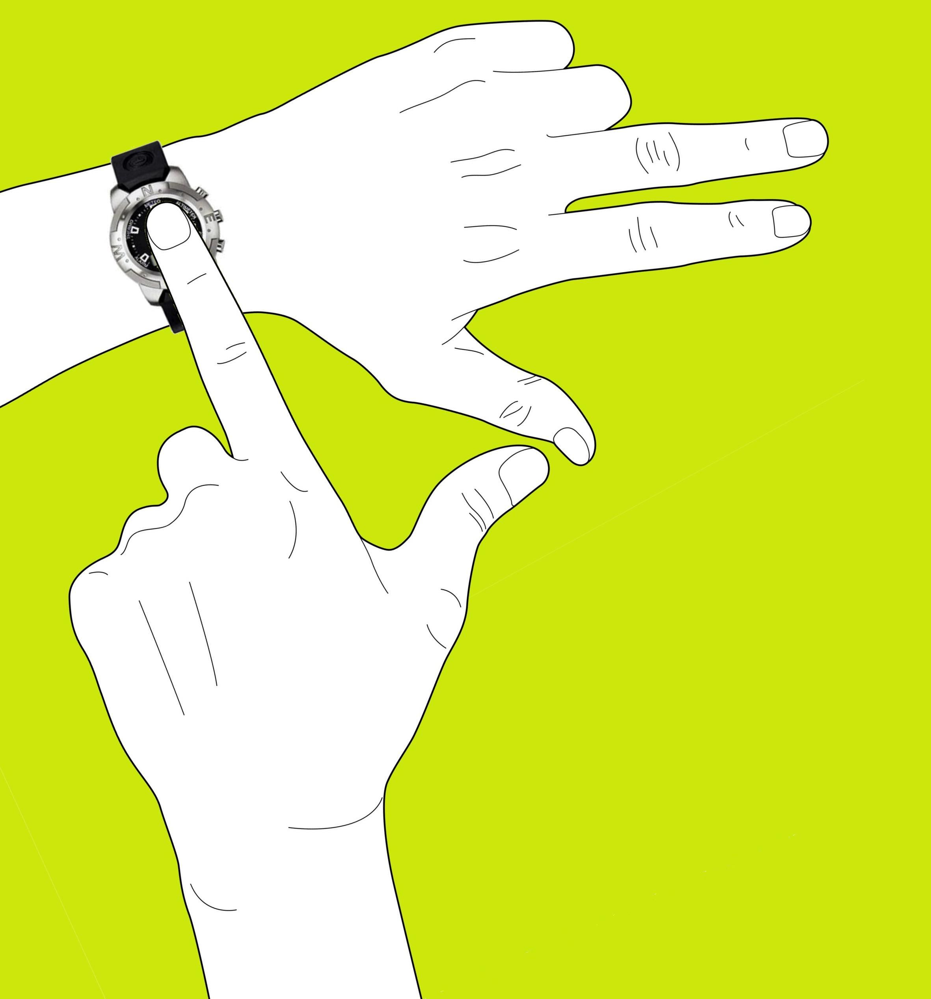
Notes:
Two problems:
- small screens
- multi-touch

Slide 10
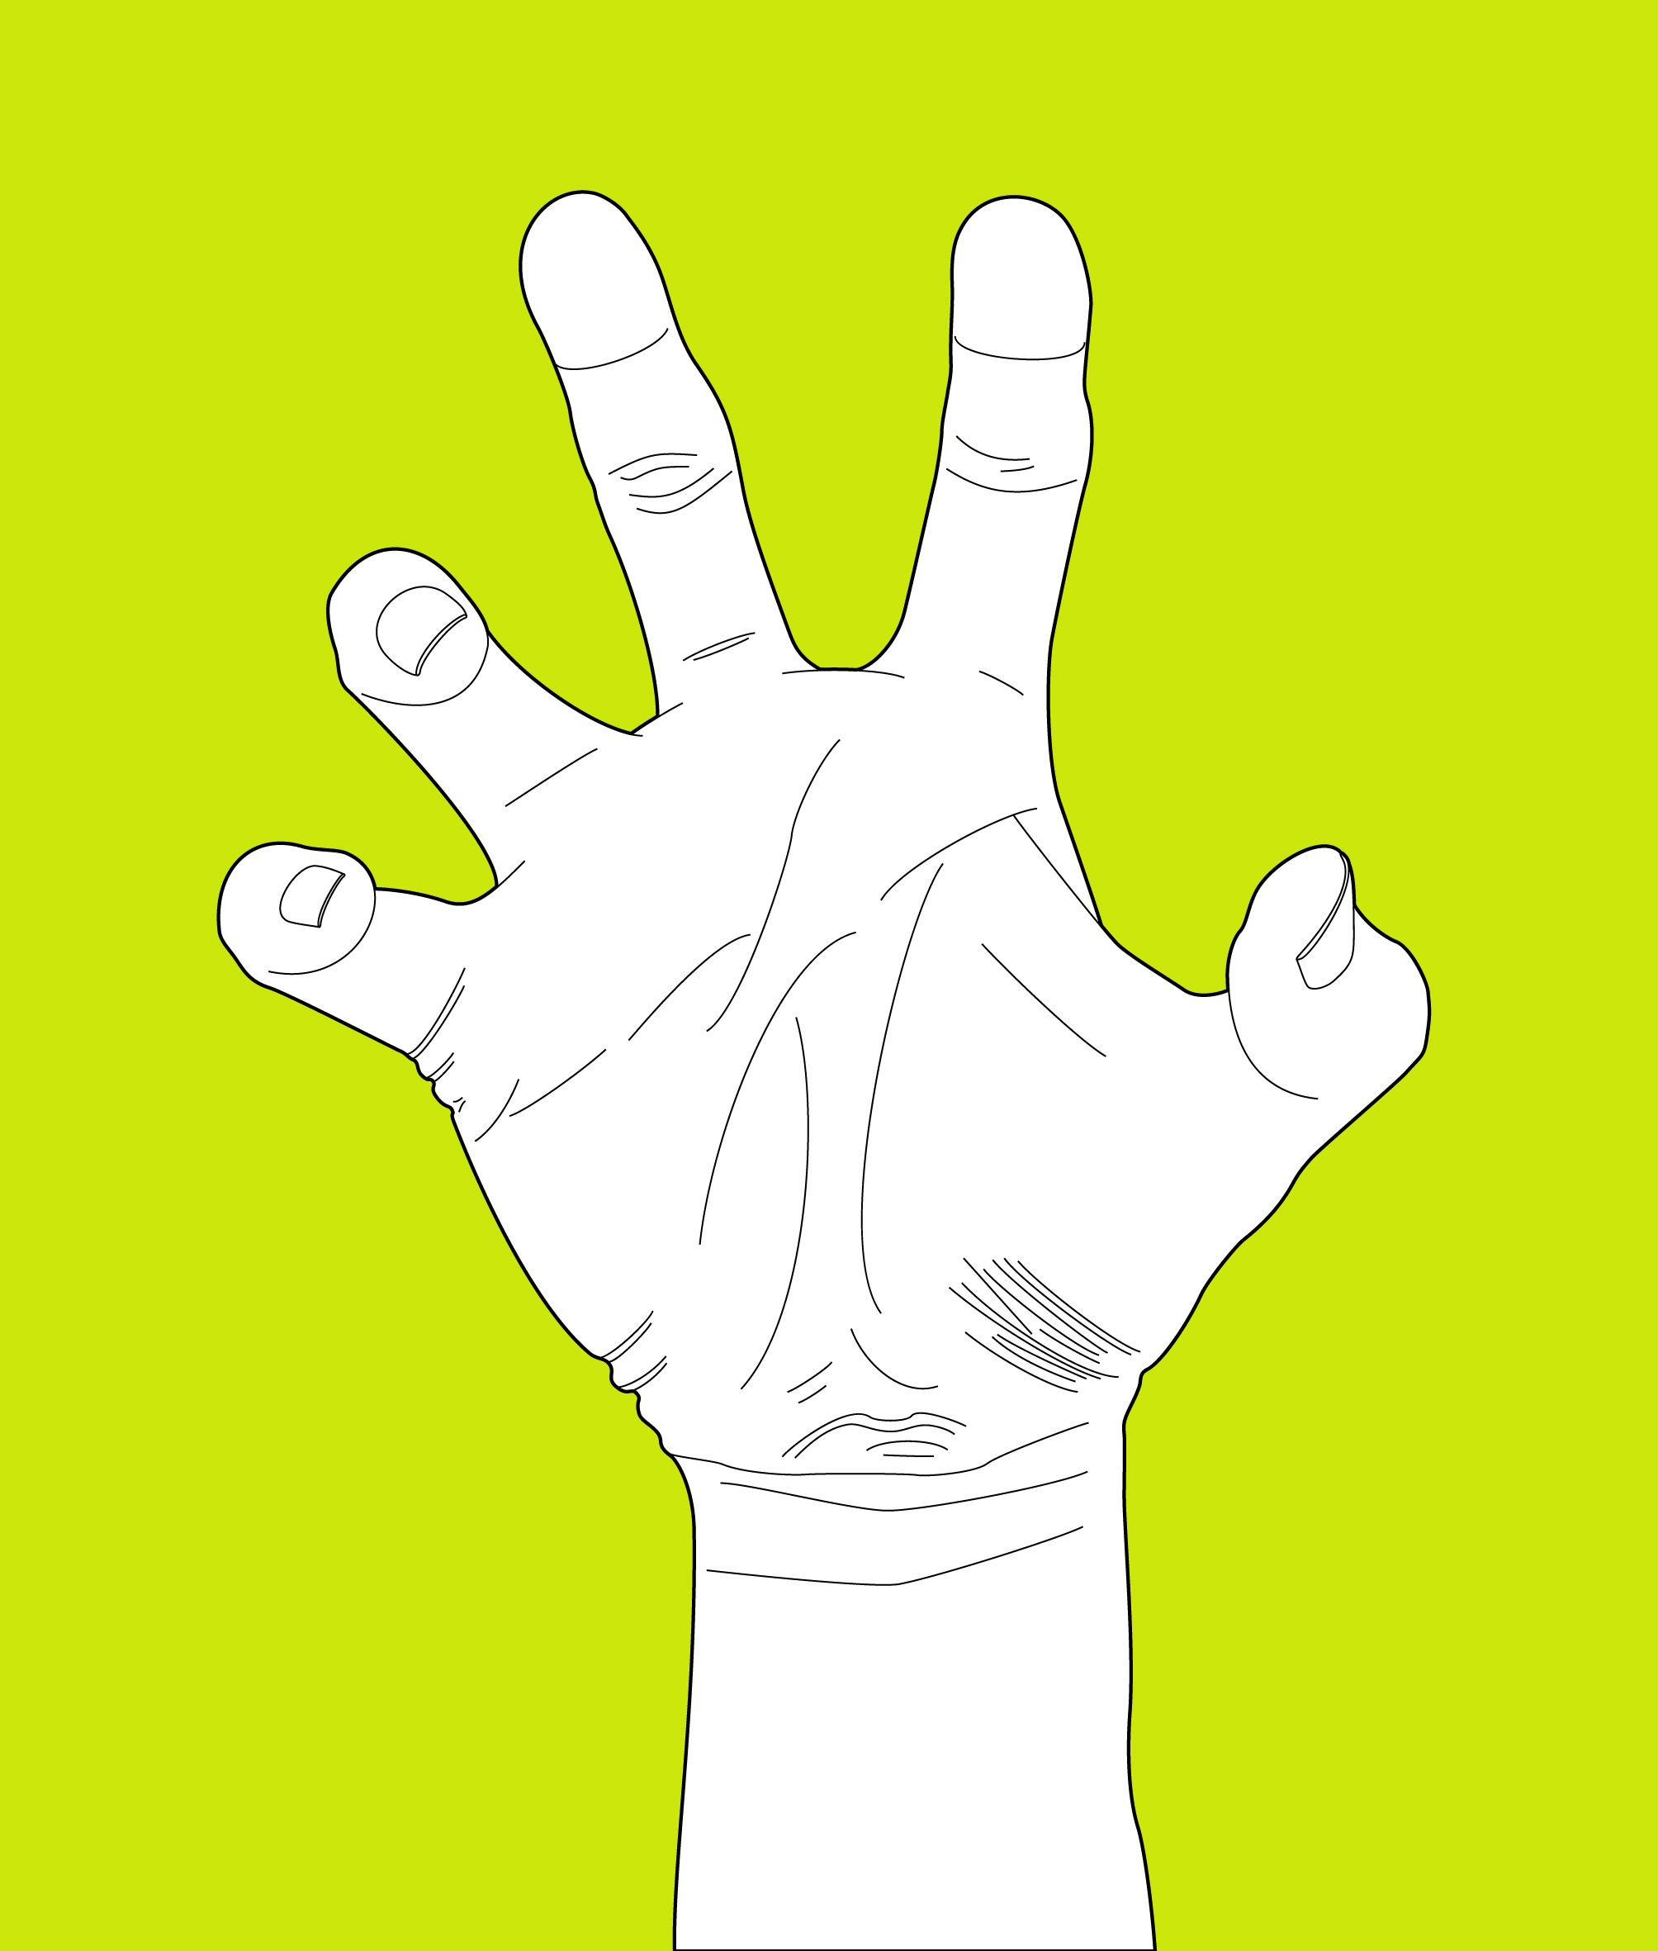
Notes:
Two problems:
- small screens
- multi-touch

Slide 11
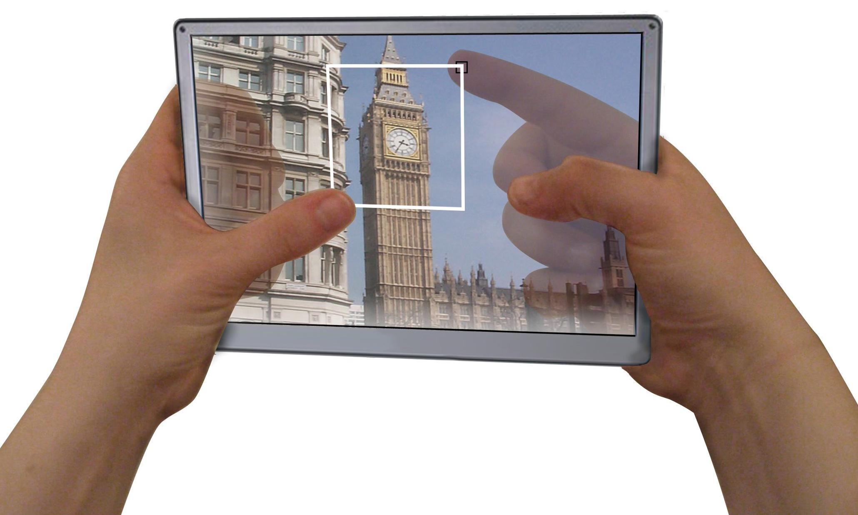
Notes:
Our solution: lucid-touch

Slide 12
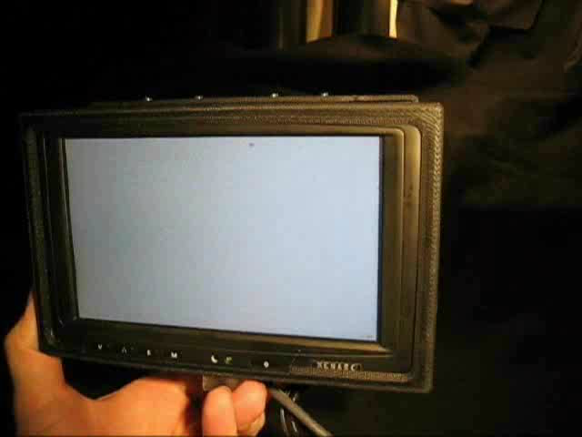

Slide 14
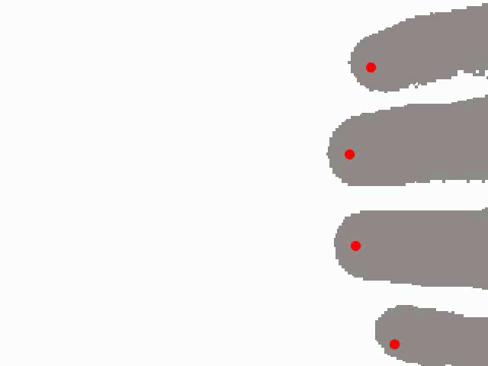

Slide 16
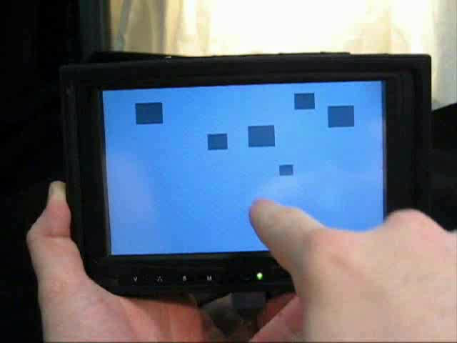

Slide 18
Under the Table (Wigdor et al. UIST 2006)

Slide 19
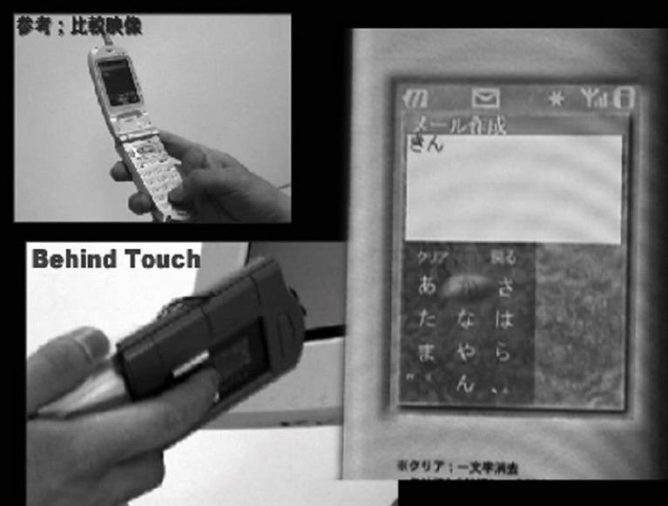
Behind Touch (Hiraoka et al. IPSJ 2003)

Slide 20
T al.
HybridTouch (Sugimoto & Hiroki Mobile HCI 2006)

Slide 21
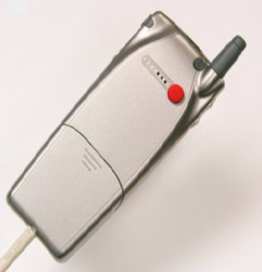
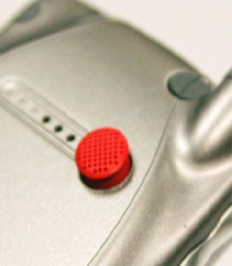
Text Entry (Chau et al. CHI 2006)

Slide 22
Video Draw (Tang 1991)

Slide 23
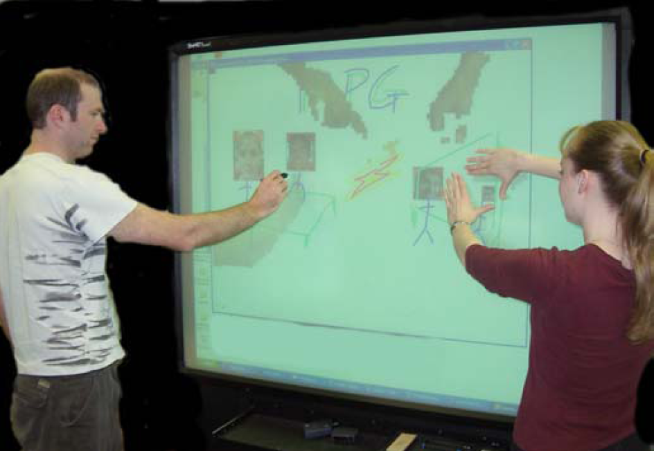
Video Arms (Tang et al. CSCW 2004)

Slide 24
Large Display Interaction (Malik et al. UIST 2006)

Slide 25
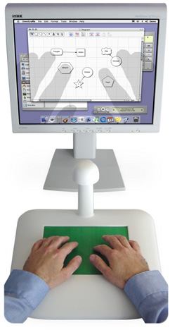
TactaPad (Tactiva - Commercial Product)

Slide 26
Notes:
MULTI TOUCH /// MULTITOUCH /// MULTITOUCH

Slide 27
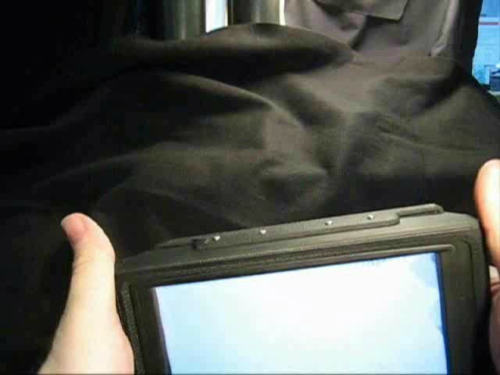
Notes:
Multi-touch

Slide 29
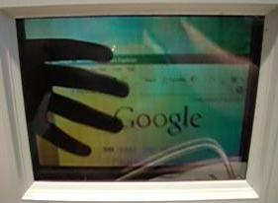

Slide 30
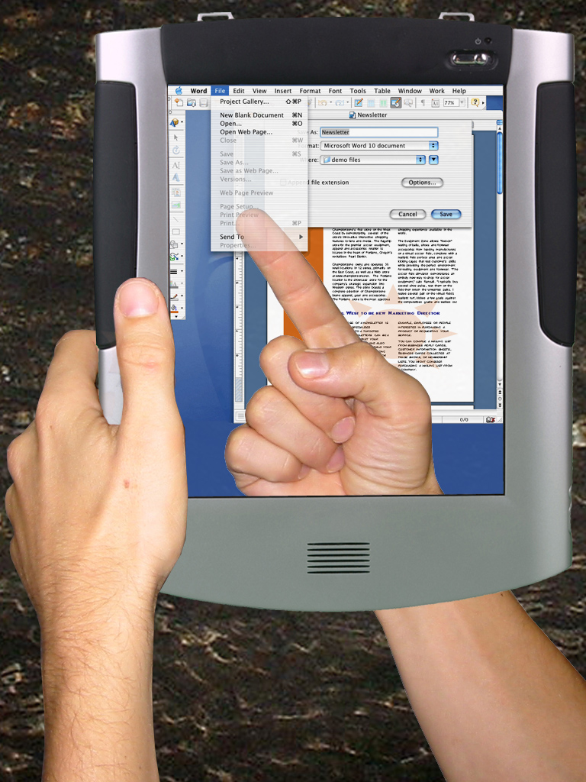
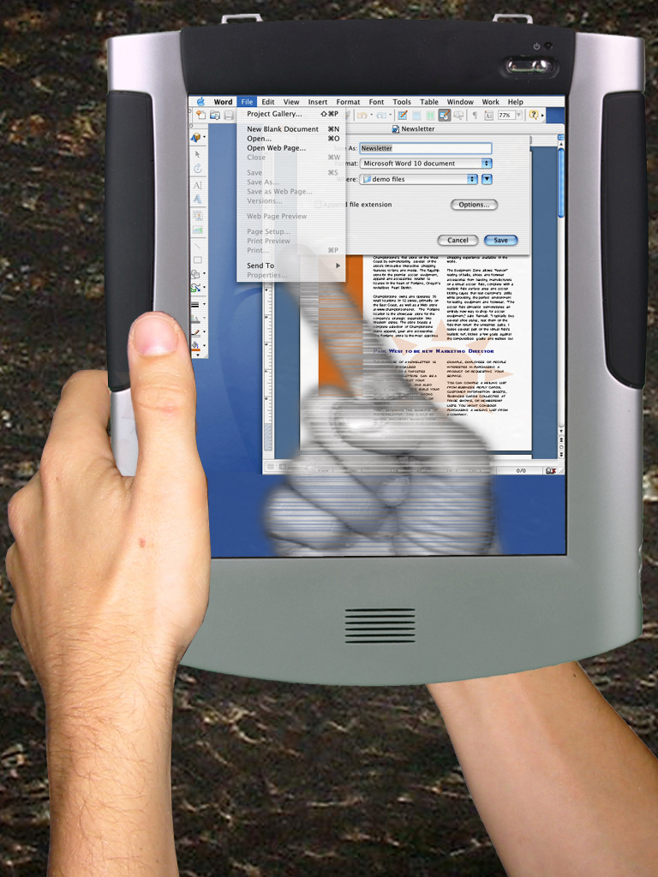

Slide 31
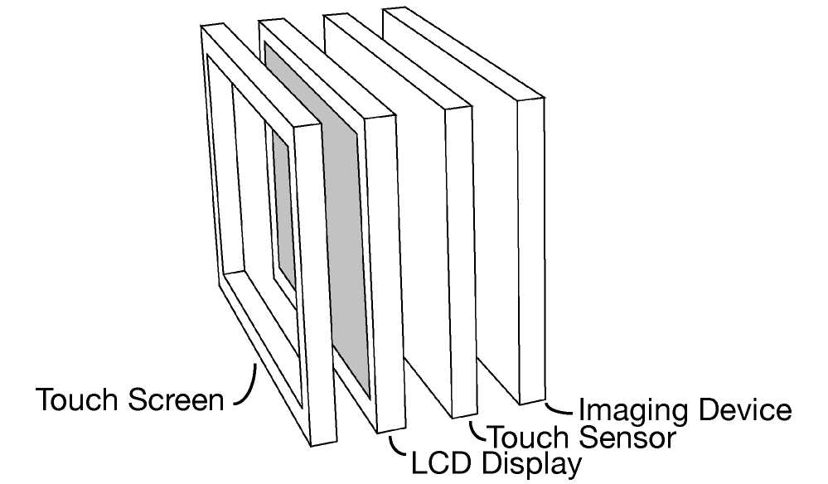
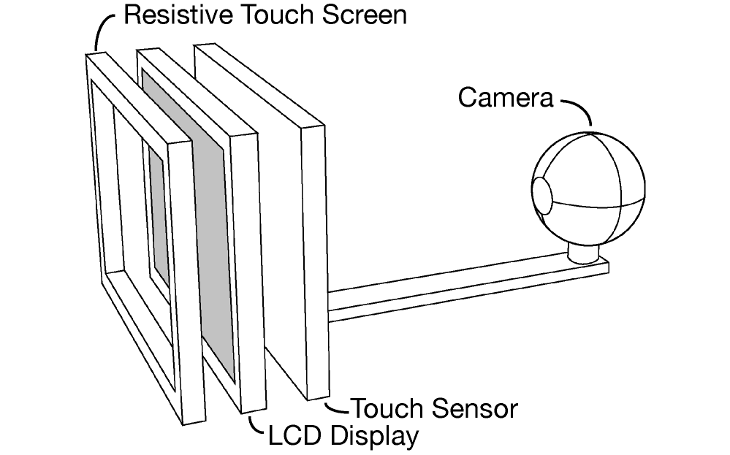

Slide 33
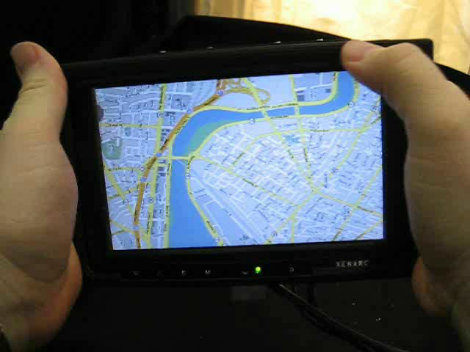

Slide 35
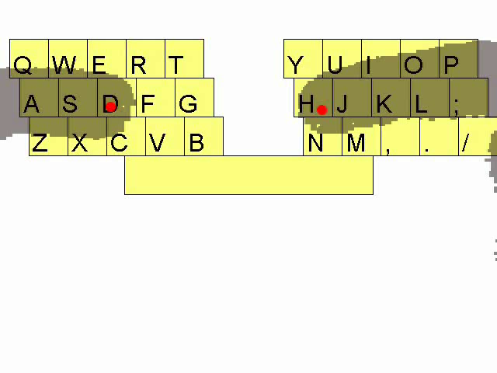

Slide 37
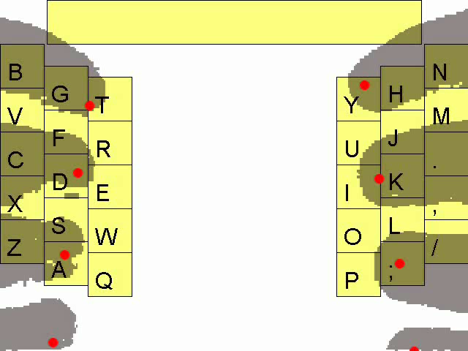

Slide 39
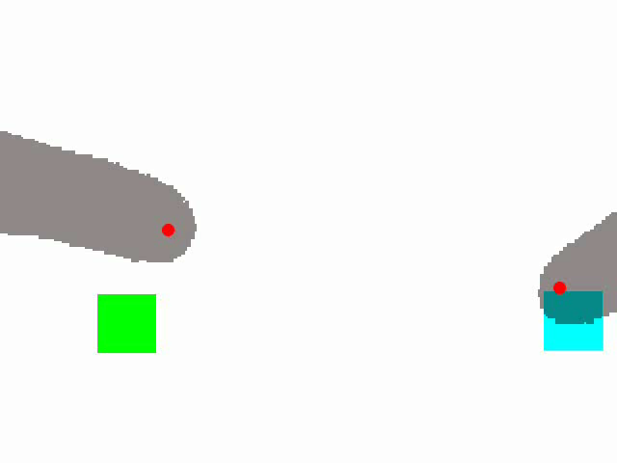

Slide 41
Notes:
The research questions

Slide 42
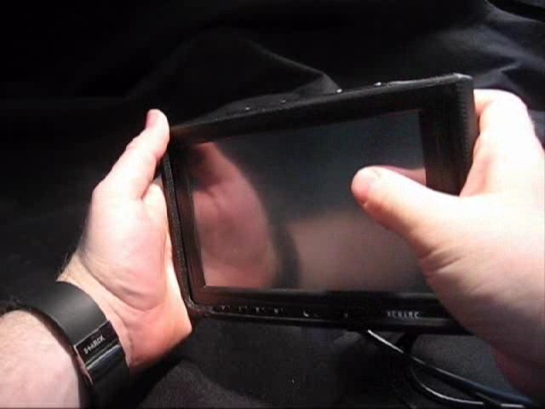
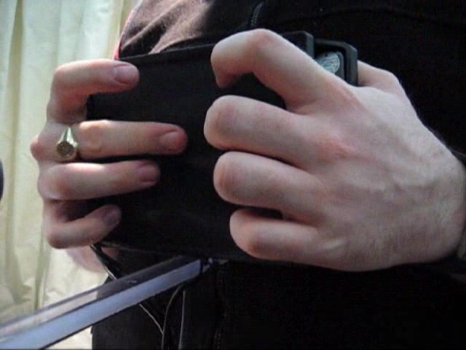
User Study Questions:
Vs.
Notes:
The research questions

Slide 43
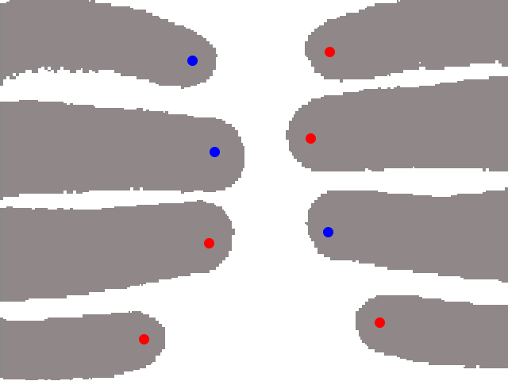
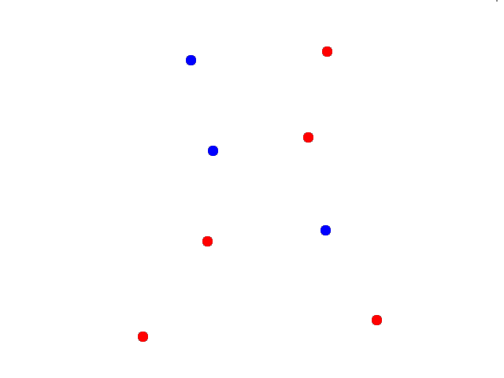
User Study Questions:
Vs.
Vs.
Notes:
The research questions

Slide 44
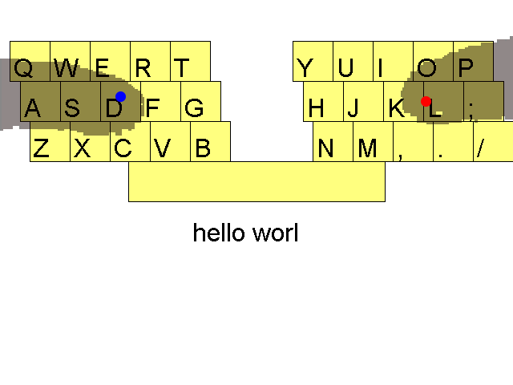
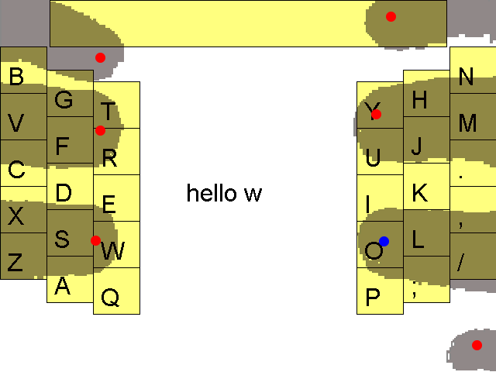
User Study Questions:
Vs.
Vs.
Vs.
Notes:
The research questions

Slide 45
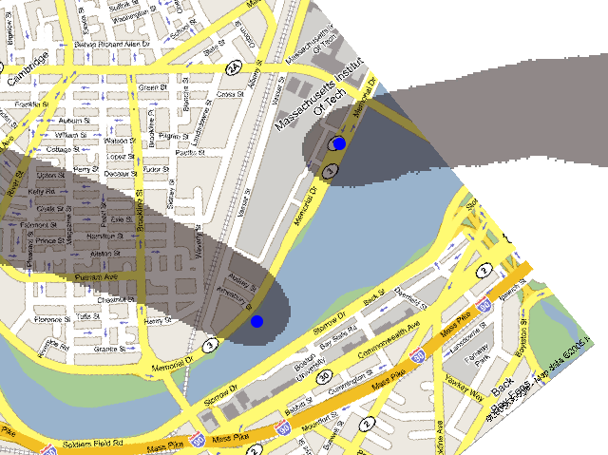
Tasks:

Slide 46
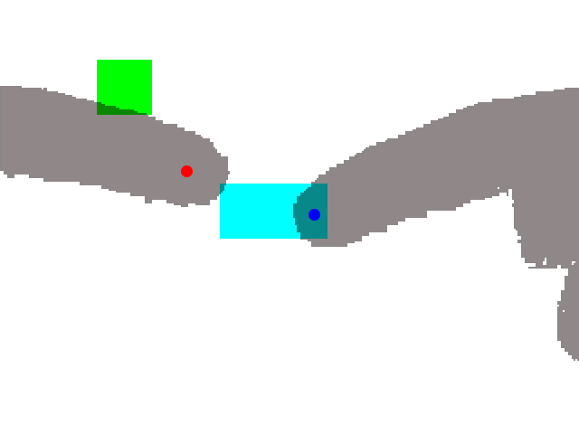
Tasks:

Slide 47
Tasks:

Slide 48
Preference: Input Face by Task

Slide 49
Preference: Input Face by Task
Map:
33%
50%

Slide 50
Preference: Input Face by Task
Map:
33%
50%
Docking:
33%
50%

Slide 51
Preference: Input Face by Task
Map:
33%
50%
Docking:
33%
50%
QWERTY:
83%
17%

Slide 52
Preference: Input Face by Task
Map:
33%
50%
Docking:
33%
50%
QWERTY:
83%
17%
i-QWERTY:
33%
67%

Slide 53
Preference: Pseudo-Transparency by Task

Slide 54
Preference: Pseudo-Transparency by Task
Map:
50%
50%

Slide 55
Preference: Pseudo-Transparency by Task
Map:
50%
50%
Docking:
67%
33%

Slide 56
Preference: Pseudo-Transparency by Task
Map:
50%
50%
Docking:
67%
33%
QWERTY:
67%
33%

Slide 57
Preference: Pseudo-Transparency by Task
Map:
50%
50%
Docking:
67%
33%
QWERTY:
67%
33%
i-QWERTY:
67%
33%

Slide 58
Results: Keyboard Layout

Slide 59
Results: Keyboard Layout
Prefer:
50%
50%

Slide 60
Results: Keyboard Layout
Prefer:
50%
50%
“Easy”:
100%
83%

Slide 61
Notes:
Our solution: lucid-touch

Slide 62
Thank you

Slide 63
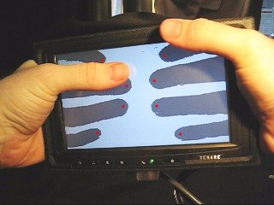

Slide 65
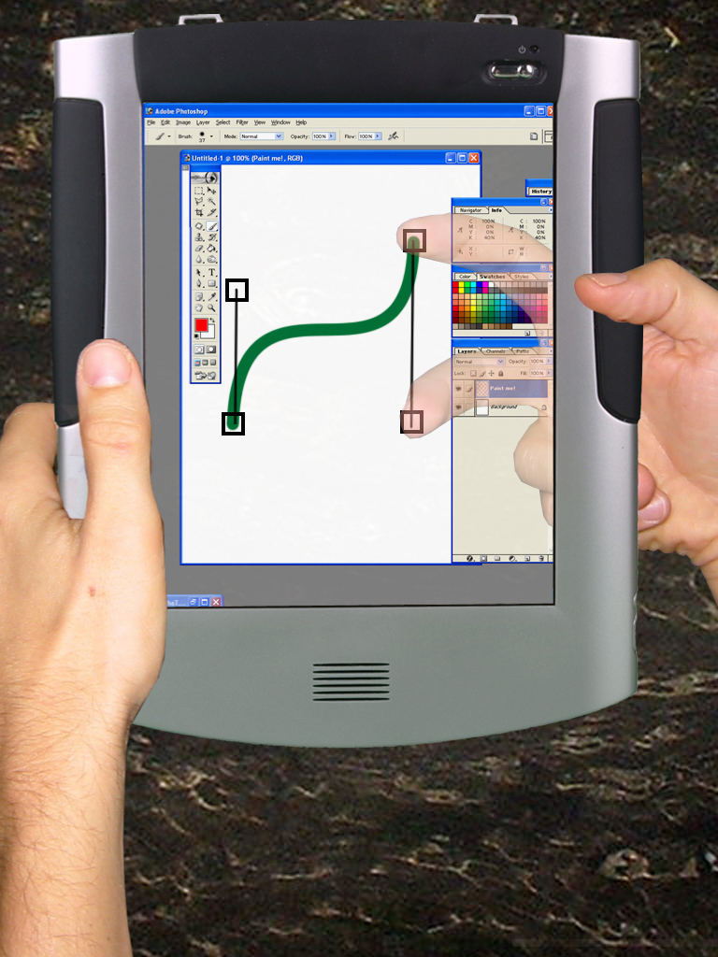

Slide 66
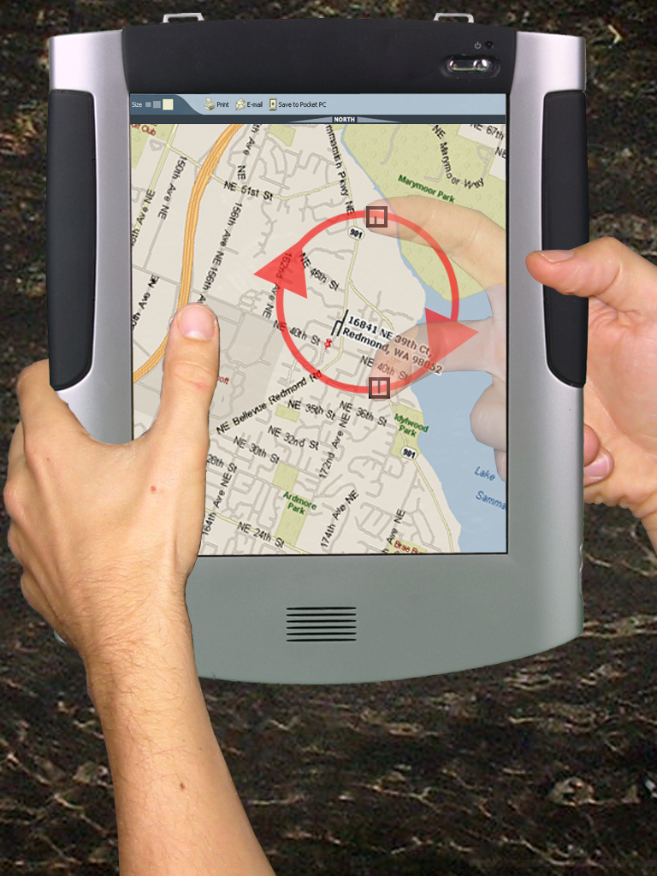

Slide 67
Out of
Range
Tracking
Dragging
Release
Button
Lift
Mouse
State
0
State
1
State
2
Replace
Mouse
Depress
Button
Notes:
1-button Mouse version (not in Buxton’s paper)

Slide 68
Passive
Tracking
Dragging
Release
Contact
State
0
State
2
Contact
Notes:
Regular touchscreen
Passive tracking = user’s eyes view of finger, not device

Slide 69
Out of
Range
Tracking
Dragging
Remove
Finger
Release
Contact
State
0
State
1
State
2
Finger
Behind Back
Contact
Notes:
LucidTouch Model
This model repeats for **EACH FINGER**
Built on next few slides

Slide 70
Out of
Range
State
0
Notes:
This model repeats for **EACH FINGER**

Slide 71
Out of
Range
State
0
Finger
Behind Back
Notes:
This model repeats for **EACH FINGER**

Slide 72
Out of
Range
State
0
State
1
Finger
Behind Back
Notes:
This model repeats for **EACH FINGER**

Slide 73
Out of
Range
Remove
Finger
State
0
State
1
Finger
Behind Back
Notes:
This model repeats for **EACH FINGER**

Slide 74
Out of
Range
Tracking
Remove
Finger
State
0
State
1
Finger
Behind Back
Notes:
This model repeats for **EACH FINGER**

Slide 75
Out of
Range
Tracking
Remove
Finger
State
0
State
1
Finger
Behind Back
Contact
Notes:
This model repeats for **EACH FINGER**

Slide 76
Out of
Range
Tracking
Remove
Finger
State
0
State
1
State
2
Finger
Behind Back
Contact
Notes:
This model repeats for **EACH FINGER**

Slide 77
Out of
Range
Tracking
Remove
Finger
Release
Contact
State
0
State
1
State
2
Finger
Behind Back
Contact
Notes:
This model repeats for **EACH FINGER**

Slide 78
Out of
Range
Tracking
Dragging
Remove
Finger
Release
Contact
State
0
State
1
State
2
Finger
Behind Back
Contact
Notes:
This model repeats for **EACH FINGER**

