Slide 1
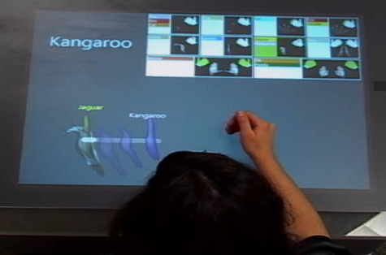
ShadowGuides: Visualizations for In-Situ Learning of Multi-Touch and Whole-Hand Gestures
Dustin Freeman
University of Toronto
Hrvoje Benko
Meredith Ringel Morris
Microsoft Research
Daniel Wigdor
Microsoft Surface

Slide 2
What The Real World Is Like
Notes:
So, let’s COME DOWN TO EARTH and see what INTERACTING WITH THE REAL WORLD IS LIKE.
In the real world, we use many different parts of our hand in subtle and expressive ways.

Slide 3
Multi-touch In The Real World
Notes:
So, currently the gestures we design in our systems are missing out on the EXPRESSIVITY that we all have a capacity for.

Slide 4
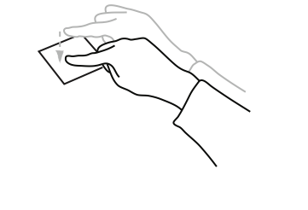
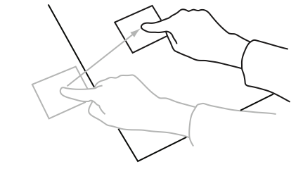
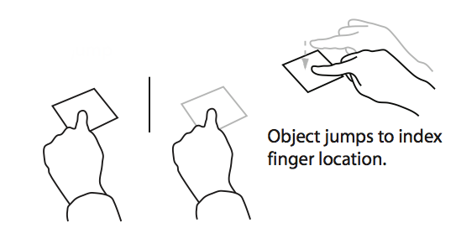
Intuitive Gestures?
“Paste”
Wobbrock J. O., Morris M. R., and Wilson A. D. User-defined gestures for surface computing. CHI 2009.
Notes:
Little agreement in abstract gestures.
(Don’t spend too much time here.)

Slide 5
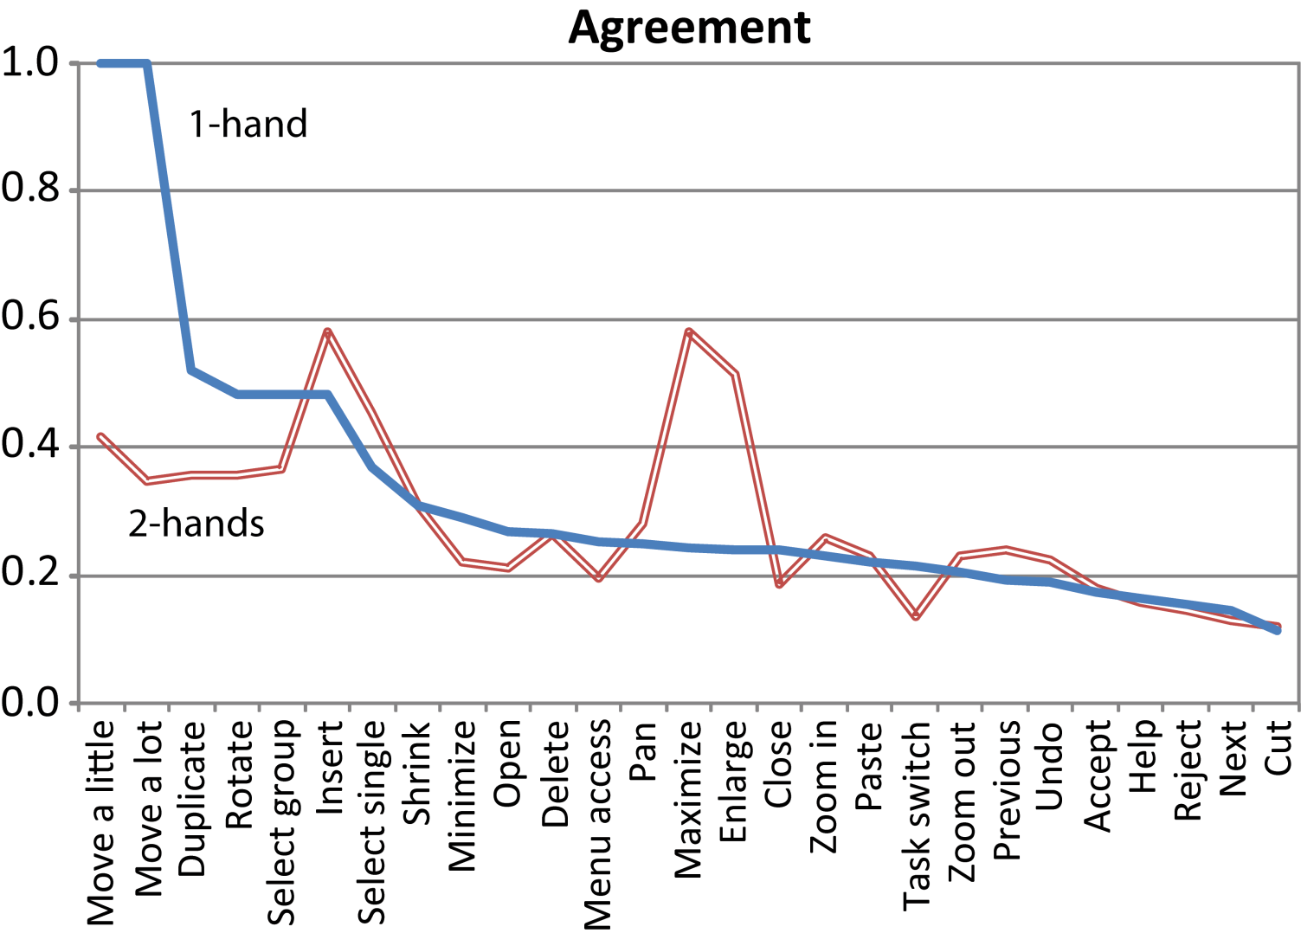
Lack of Agreement
Notes:
Physically analogous gestures are guessable. Abstract actions (which is what we were interested in anyway) have very little agreement when users are guessing.
Option A: build your entire gesture interface around the RECOGNIZABLE GUI.
Option B: TEACH people gestures. THIS IS WHAT WE WILL DO.

Slide 6
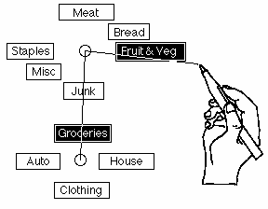
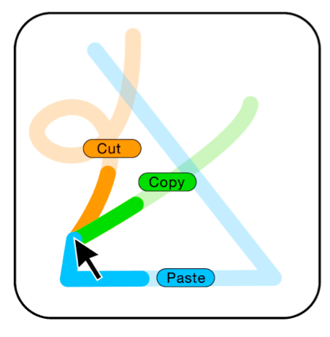
Single-Point Stroke Gestures
Kurtenbach G. and Buxton W. Issues in combining marking and direct manipulation techniques. UIST 1991.
Bau O. and Mackay W.E. OctoPocus: a dynamic guide for learning gesture-based command sets. UIST 2008.
Notes:
(Don’t use term feedforward)
Let’s look at an implementation of dynamic guides on the tabletop…

Slide 7
Single-point dynamic guides
Notes:
MY IMPLEMENTATION.

Slide 8
Single-point dynamic guides
Notes:
This works fine for one point, but WHAT IF I want my user to put 5 fingers down and move in a circle…

Slide 9
Multi-point dynamic guides
Notes:
Let’s see dynamic guides teach the gesture of putting 5 fingers down and rotating in a circle.
Five finger gesture rotating in a circle.
[PLAY VIDEO]

Slide 10
Multi-point dynamic guides
Notes:
Dynamic Guides does not SCALE to multitouch.
WHY does this fail?...
User cannot see what they are supposed to do. Most of the stuff is underneath the user hand. MOTIVATION TO NEXT.
Now I’m going to talk about our system…..

Slide 11
Idea: The User Shadow
Notes:
INTRODUCE more.

Slide 12
Idea: The User Shadow
Notes:
DIFFUSED ILLUMINATION
OFFSET shadow solves OCCLUSION problems.
Emphasize the value of the FEEDBACK in the shadow.
Seeing the hand as a whole helps with ORIENTATION.
Problem CANNOT be solved using the best computer vision system on the planet

Slide 13
Gesture As State Machine
Current single-point stroke methods
Notes:
OOR = out of range.
Relate back to dynamic guides.

Slide 14
ShadowGuides Overview
Registration Pose Guide
User Shadow Annotations
Notes:
We shall use…
User Shadow Annotations EXTEND dynamic guides

Slide 15
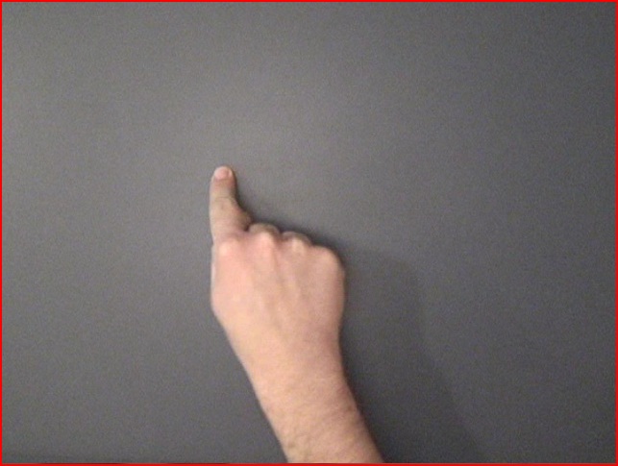
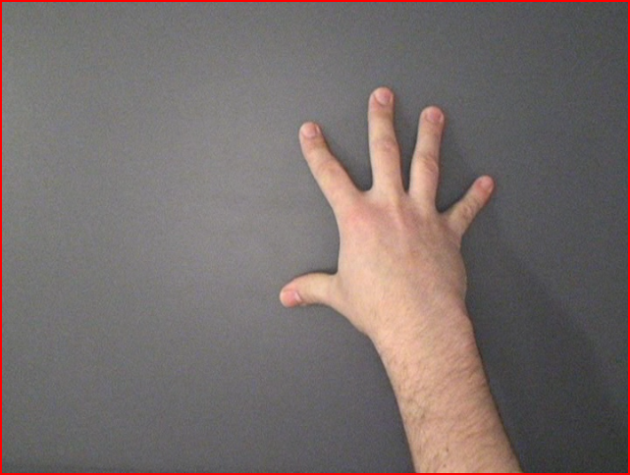
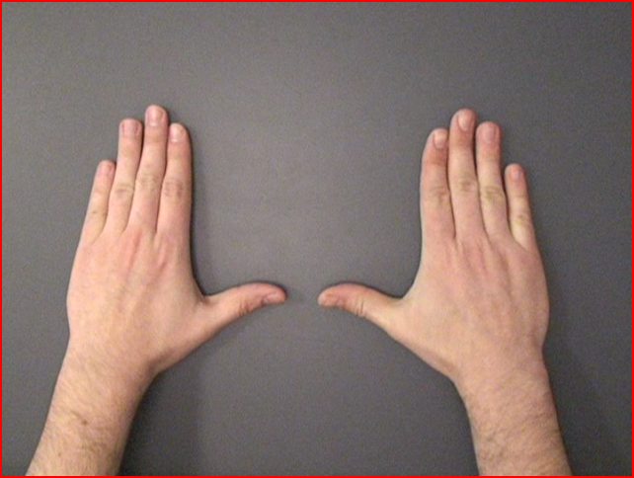
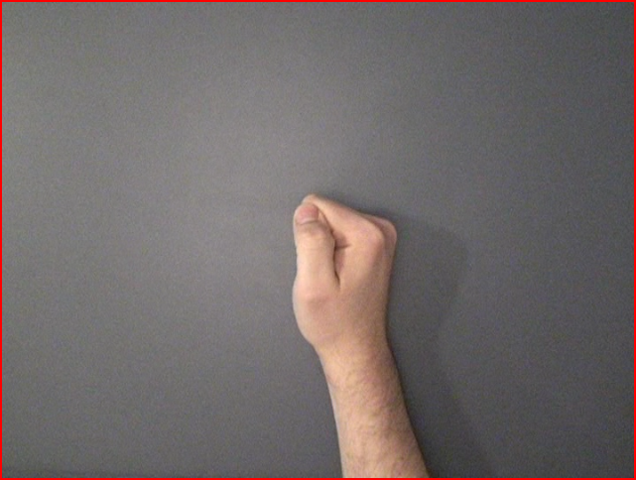
Registration Pose
Notes:
One way to start single point + path gestures, many POTENTIAL ways to start multi-touch and whole hand gestures.
Goal: The physical actions of a NOVICE should be the SAME as an EXPERT. Aids the TRANSITION to an expert user.
DEFINE IN SITU
Next steps the user must perform are shown relative to their current state
EXAMPLE of a novice user invoking help from a single point for a gesture that starts with a fist.

Slide 16
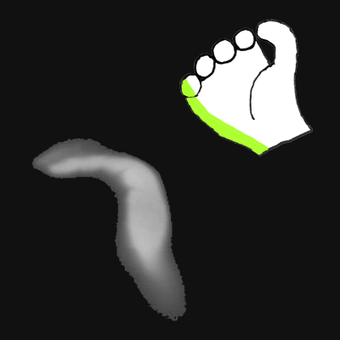
Registration Pose Visualization
Notes:
SELL! Say what it ACCOMPLISHES.
Our registration pose guide shows two views of a given registration pose: the shape of the contact area on the surface, as represented by a raw visual input from the Microsoft Surface (more on that later), and the parts of the hand(s) used to make that shape on a cartoon hand.
Showing two representations was done for a few reasons:
It can be hard to tell what parts of the hand are being used for, given only the contact shape
Given only the cartoon hand, it is unclear what kind of contact shape should be made with it

Slide 17
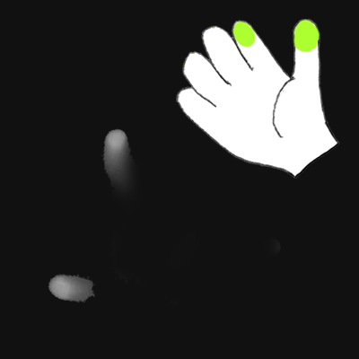
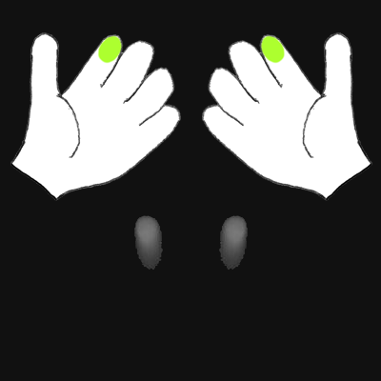
Expert Style
Notes:
(REVERSE) PINCH gesture example
While it may be performable using contacts coming from different hands then intended, it won’t be comfortable or efficient.

Slide 18
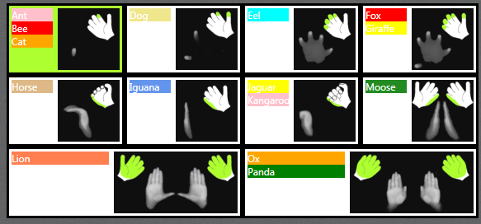
Registration Pose Guide
Notes:
CHEAT SHEET. Gives the user an overview of all possible registrations in this system.
Not in-situ
MULTIPLE gestures may be available from the same registration pose.
Let’s perform the CAT gesture.

Slide 19
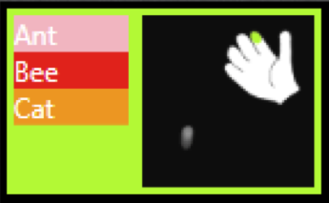
The “Cat” Gesture
Registration Pose Guide
User Shadow Annotations
?
Notes:
We shall use…
User Shadow Annotations EXTEND dynamic guides

Slide 20
Cat Gesture Video
Notes:
Let’s look at a sample gesture that could be hard to teach.

Slide 21
Cat Gesture Video
Notes:
We can express motions of the gesture, but we also need to cue them to stop and add another finger at a certain point.

Slide 22
Learning The Cat Gesture
Notes:
Let’s watch the user performing the gesture with ShadowGuides

Slide 23
Learning The Cat Gesture
Notes:
Let’s watch that gesture again from the view of the user shadow annotations.

Slide 24
User Shadow Annotations
Notes:
We annotate the user shadow with not only dynamic guides, but also dynamic markers to represent cues.

Slide 25
User Shadow Annotations
Notes:
Lets look at key frames.

Slide 26
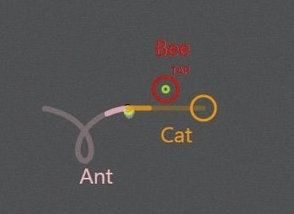
User Shadow Annotations

Slide 27
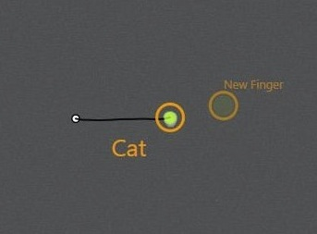
User Shadow Annotations

Slide 28
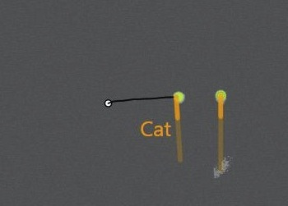
User Shadow Annotations

Slide 29
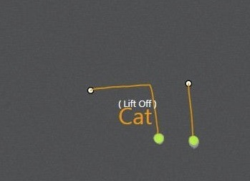
User Shadow Annotations

Slide 30
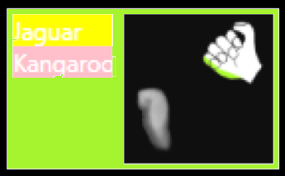
Annotations for Contact Shape
Notes:
The user has just put their fist down – and there are two gestures possible from this starting pose.
contact shape KEYFRAMES for shape deformation
Now you have seen ALL of ShadowGuides!

Slide 31
Evaluation
Standardized multi-touch gesture learning evaluation method.

Slide 32
Evaluation
Standardized multi-touch gesture learning evaluation method. Right?
Notes:
Joke: So I’m on an internship for a first time, and I’m like, so guys, whats the standard test to determine how well your system teaches gestures?
And they’re like, uhhhhhhhh that doesn’t exist yet.
So my work was not done yet.
No one has a map for the space of multi-touch and whole hand gestures. This motivates our Taxonomy.

Slide 33
Taxonomy
Notes:
We build our taxonomy based on User-Defined Gestures work in CHI 2009. They used form, nature, binding, and flow, but we are semantics-agnostic, so we only focus on the form on the gesture, which we expand to
Registration Pose, Continuation Pose and Movement
While it may be impossible to anticipate every difficulty that could arise with a complex gesture, this mapping of the set of gestures, which has some validity as it comes from observation of users, is useful to understand what is possible.
What is NOT included: timing-relevant gestures: double-tap for example.

Slide 34
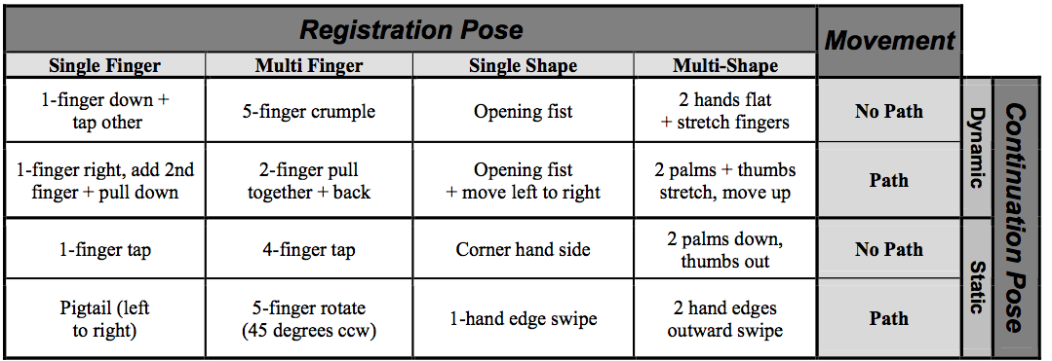
Representative Gesture Set
Notes:
Gestures in LITERATURE. Had to invent COMPLICATED gestures
We reserve the ONE-FINGER tap for invoking the help system.
We OFFER this set to the community to provide a basis of comparison for gesture learning.
The entire gesture set is shown in a video accompanying the paper.
Our NEXT PROBLEM was that there we need a suitable BASELINE comparison.

Slide 35
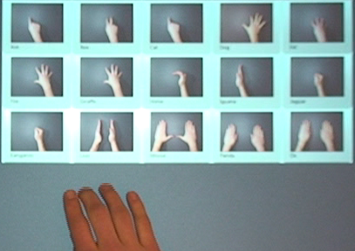
Baseline: Video
Notes:
We built a menu of tap-able videos for each gesture.

Slide 36
Baseline: Video
Notes:
Video emphasizes the OPPOSITE properties of ShadowGuides
No feedback
Not interactive
-Easy to make

Slide 37
Evaluation
Between-subjects comparison
11 participants Video
11 participants ShadowGuides
8 blocks of 15 gestures each
Learning Phase: 7 blocks with help
Memory Phase: 1 block with no help
Notes:
In each trial, users were cued to perform a gesture, named after an animal.
People did not KNOW they were going to be tested in the memory phase.
We MEASURED: Time of each trial, # of attempts, if they invoked the menu or not.
No significant QUANTITATIVE differences were found in the LEARNING PHASE. Variation in learning was very high across users, however, so any inter-method variation would have been obscured.
Other data:
Users were between the ages of 18-50 and had used nothing more complicated than a touch-sensitive phone
Participants took between 60-90 minutes.

Slide 38
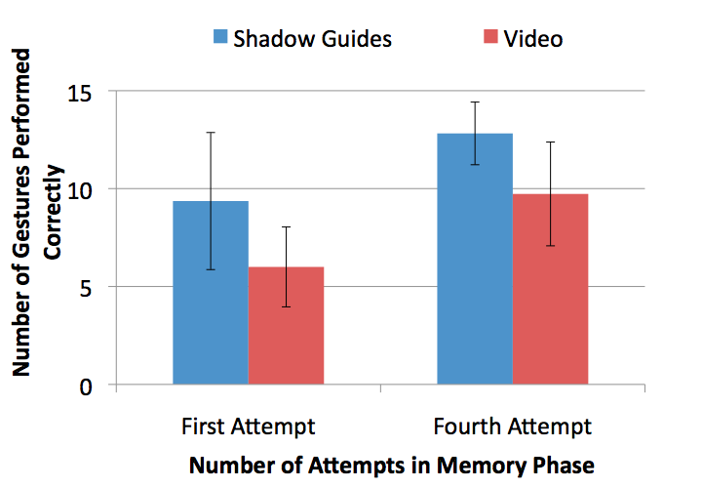
Memory Phase Results
Notes:
Explain AXES
Participants using ShadowGuides were significantly more successful in performing gestures during the memory test.
First attempt: 50% more gestures for SG. 9.4/15 SG 6/15 V
Fourth attempt: 30% more gestures for SG. 12.8/15 SG 9.7/15 V
(this gap does not close after the 4th attempt)
SG scored better or equal on Likert
While there were no clear QUANTITATIVE results in the learning phase, our QUALITATIVE observations were quite different.
Extra Data Observations:
EVERY gesture was either more often or equally remembered by ShadowGuides participants, after both 1 and 4 attempts.
Some gestures were (unsurprisingly) much harder to remember and/or perform than others.
-Manually categorized errors in the memory phase by watching video after the trial as errors in PERFORMANCE or errors in MEMORY. There were obviously more errors in the video mode, but both there were much more of both types of errors. If watching video relative to ShadowGuides only had an effect on the details of the gesture, then we would only expect an increase in errors in performance.
-Every user performed each gesture at least once correctly during the learning phase.
ShadowGuides First Attempt:
Median: 10. Mode and Max: 13 (3 users). Min: 3
Video First Attempt:
Median and Mode: 6 Max: 11 Min: 3

Slide 39
Observations and Next Steps
Video shows the gist of the gesture
ShadowGuides shows details
Hybrid approach?
Notes:
Users would essentially MIMIC THE VIDEO, missing details.
SG users were learning a gesture for the first time with SG, they would move very SLOWLY and CAUTIOUSLY. Perhaps video or animation could be used in concert with our annotations to alleviate the first-time experience.
CLAIM: teaching dynamically gives people exactly the information they need at exactly the right time, and helps them remember details, but does not inspire confidence or provide an overview.
An expert gestures confidently and accurately. While a video shows people subtle cues on how to behave, it cannot show details. The exact same situation can arise when a live teacher is demonstrating the gesture for the user. It is hard to mimic something exactly unless we emphasize what parts are the most important.

Slide 40
Thanks to:
Jarrod Lombardo Paul Hoover
Sarah Williams Xiang Cao
Tony Tang
Andy Wilson
Ken Hinckley
Dennis Wixon August de los Reyes
Clifton Forlines
Dustin Freeman
dustin@cs.toronto.edu
www.dustinfreeman.org
Notes:
Contributions: ShadowGuides, Taxonomy, Representative Gesture Set, User Study observations.
SG represents a POINT in the design space. We have opened up the design space and given a map in the form of the taxonomy.

