Slide 1
WeSearch: Supporting Collaborative Search and Sensemaking on a Tabletop Display
Meredith Ringel Morris
Jarrod Lombardo
Daniel Wigdor
Notes:
2/9/2010

Slide 5
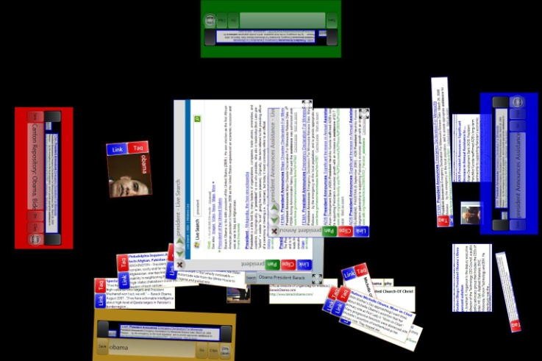
Notes:
Traits Required – Roadmap:
Morris & Horvits – TRAITS:
Awareness
Division of labour
Persistence of session
GOALS
Sensemaking
Text entry
Clutter
Orientation

Slide 6
Related Work
Notes:
Collaborative search
Search on Tabletops

Slide 7
WebGlance CSCW 2004 Maekawa et al. PERCOM 2006 SearchTogether UIST 2007 CoSearch CHI 2008 Cerchiamo SIGIR 2008
Related Work: Collaborative Search
Notes:
WebGlance: pda+wall
Maekawa: sections on mobiles
SearchTogether: remote PC’s
CoSearch: phones + shared PC
Cerchiamo: 2 dedicated PC’s plus wall

Slide 8
Personal Digital Historian CSCW 2002 TeamSearch Tabletop 2006 Físchlár-DT Multimedia Systems Journal 12,4 Cambiera Euro Viz 2009 WebSurface Tabletop 2009
Related Work: Search on Tabletops
Notes:
Specialized Domain
PDH: Filters Who, What...
TeamSearch: Tagged Images
Fishclar: Video library
Cambiera: visual analytics
----------
WebSurface:

Slide 9
Notes:
Tabletop Search:
Traits &
Goals / challenges

Slide 10
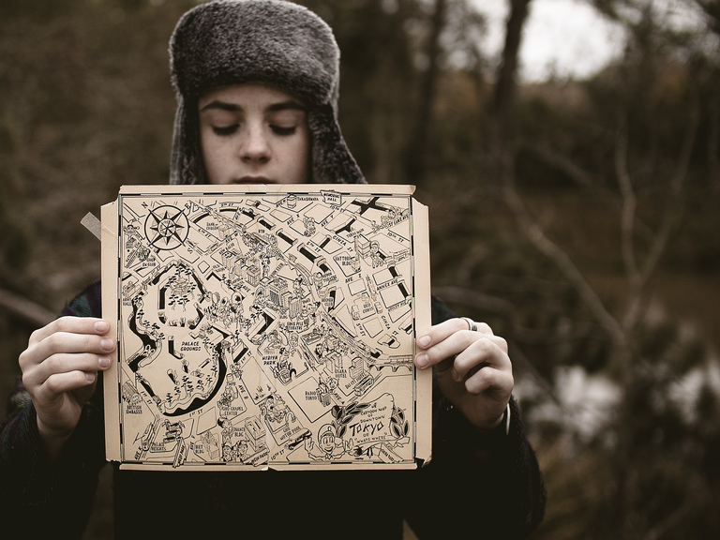
Notes:
Traits Required – Roadmap:
Morris & Horvits:
Awareness
Division of labour
Persistence of session

Slide 11
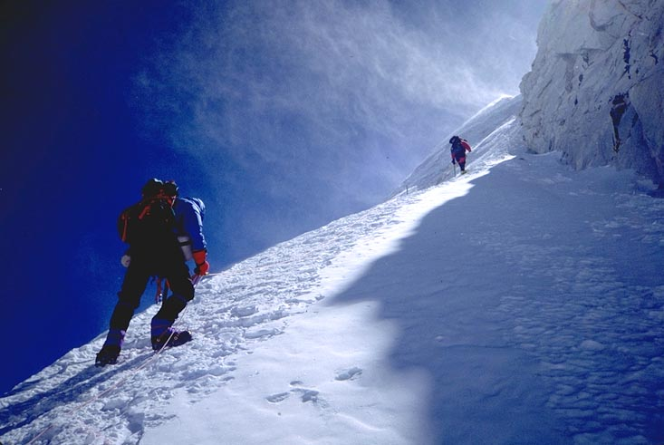
Notes:
Goals/Challenges:
Sensemaking: Who/What/When/Where/How/Why?
Text entry
Orientation
Clutter
--
Recall:TRAITS:
Awareness
Division of labour
Persistence of session

Slide 12
Notes:
WALK YOU THROUGH
Then, USER STUDY
orientation

Slide 13
Toolbar

Slide 15
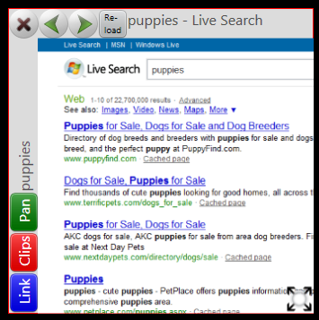
Notes:
Browser Controls:
Browser
Resize
Pan/Link

Slide 16
Browser Controls

Slide 18
Notes:
2-handed input:
Links button
Pan button
Clips: Sensemaking & clutter

Slide 19
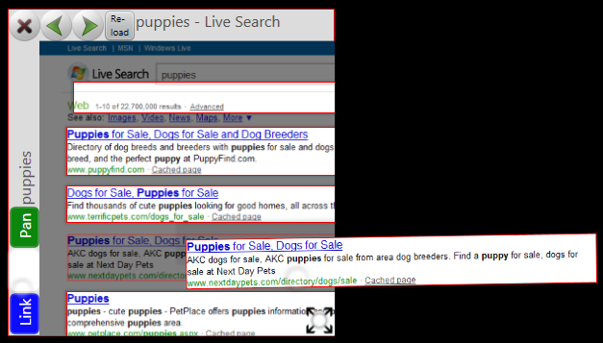
Notes:
Clips: sensemaking & Clutter

Slide 20
Clips
Notes:
Sensemaking & clutter

Slide 21
Notes:
Sensemaking & clutter

Slide 22
Notes:
Tags: Sensemaking & text entry
META DATA
Who: user who created
What: content type (text, image, etc)
Where: The URL of the Web page
When: creation timestamp
Why: tags
How: query keywords used to find

Slide 23
Who
Notes:
Tags: Sensemaking & text entry
Who: user who created

Slide 24
What
Notes:
Tags: Sensemaking & text entry
What: content type (text, image, etc)

Slide 25
Where
Notes:
Tags: Sensemaking & text entry
Where: The URL of the Web page

Slide 26
When
Notes:
Tags: Sensemaking & text entry
When: creation timestamp

Slide 27
Why
Notes:
Tags: Sensemaking & text entry
Why: tags

Slide 28
How
Notes:
How: query keywords used to find

Slide 29
Notes:
Division of labour

Slide 30
Clip Search
Notes:
Division of labour

Slide 31
Notes:
Division of labour
News
Images
Web
Keywords

Slide 32
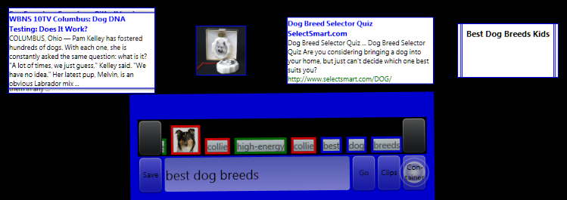
Notes:
Division of labour
News
Images
Web
Keywords

Slide 33
Notes:
Awareness & orientation
text entry

Slide 34
Notes:
Awareness & orientation
text entry

Slide 35
Notes:
What goes in there?

Slide 36
Notes:
Tokens & Terms

Slide 37
Notes:
Page Titles

Slide 38
Notes:
Clips

Slide 39
Marquee
Awareness & Text

Slide 40
Notes:
Awareness & orientation
text entry
Flashing touching

Slide 41
Notes:
Clutter
Persistence & Sensemaking
Text entry

Slide 42
Container

Slide 43
Notes:
Text entry
Clutter
sensemaking

Slide 44
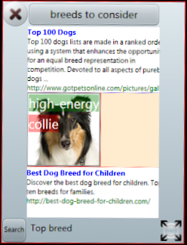
Notes:
Persistence

Slide 45
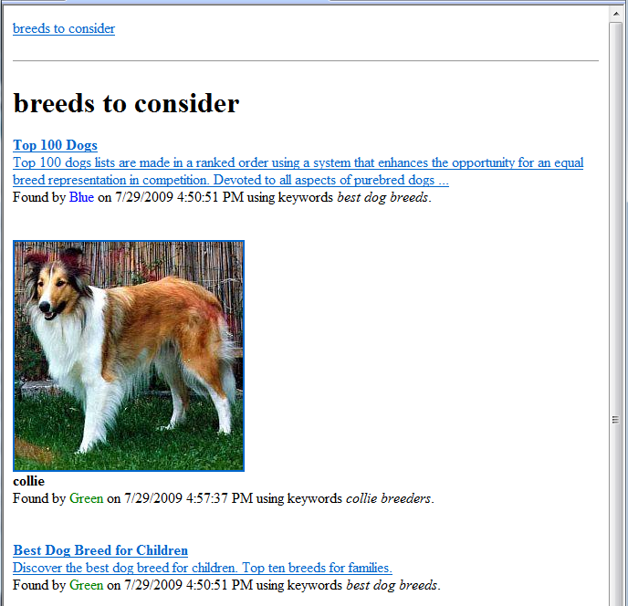
Notes:
Persistence

Slide 46
Save-Out

Slide 48
Notes:
Who, what, when, where, how, why

Slide 49
Evaluation
Notes:
Questions:
Types of search tasks?
How will groups use it?
Effective? TRAITS: division of labour, Awareness, Persistence of session
GOALS/CHALLENGES: Sensemaking, Text Entry, Orientation, Clutter
Participants:
11 groups of 4, coworkers, families, etc.

Slide 50
Methodology
Notes:
Bring a search task!
Interview: task details, how to find this?

Slide 51
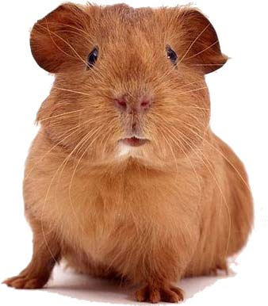
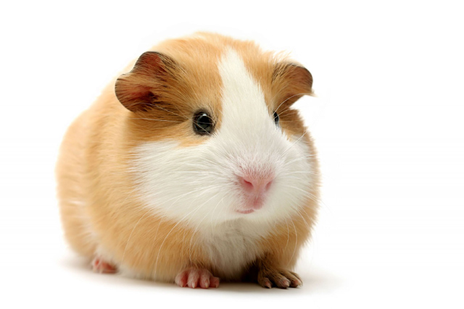
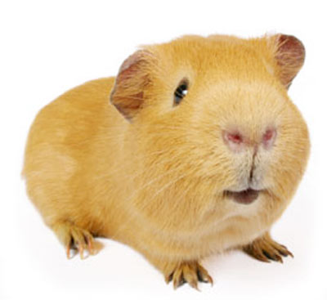
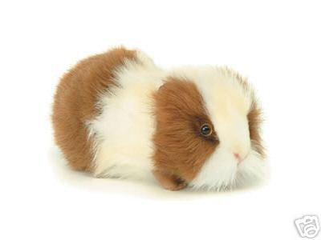
Notes:
Eg tasks:
Shop: Plan Company Offsite (coworkers)
Shop: New computer (family)
Find: Antimicrobial peptides for identifying bacteria (coworkers)
Treatments: Alzheimer’s (students)
Plan a trip (families)
background research on a plaintiff (lawyers)
Tutorial
Free to ask for help
30 minutes
Questionnaires

Slide 52
Results: Overall
Notes:
Easy to learn (6/7)
Helpful (5/7)

Slide 53
Results: Traits
Notes:
Awareness, division of labour, persistence

Slide 54
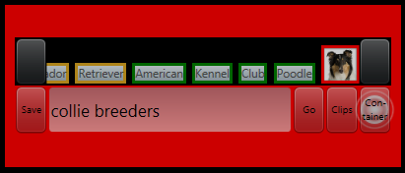
Awareness
Notes:
Big display, marquee
Shared display: 6/7, high awareness (5/7)
Display: Liked: “we are able to see what each person is working on and can expand on that particular idea.”
Marquee: “I found search terms coming up that I did not anticipate and this improved the value and speed of the searches”
Company offsite: “Why did you put weddings?”
Lawyers: “why McDonald’s?”
Sometimes too cluttered, too much space,

Slide 55
Division of Labour
Notes:
Clips feature, multi-touch table
Did not use CLIPS BUTTON to divide labour, 2 of 11 used at all
Large table did enable division
Divide and conquer + oral communication

Slide 56
Persistence
Notes:
Valuable (6/7)
9 of 11 pressed “SAVE”

Slide 57
Results: Goals/Challenges
Notes:
Sensemaking, Text Entry, Clutter, Orientation

Slide 58
Sensemaking
Notes:
Clips
Tags & meta info
Containers
Clips useful: 6/7, ~40 clips per group
Tags: only 2 of 11 groups
Containers: ~ 6 per group

Slide 59
Text Entry
Notes:
Marquee, suggested search
Strongly disliked text entry w/ virtual keyboard
Search by example: ~3 per group
~70% all text entry done by text re-use

Slide 60
Clutter
Notes:
Clips, containers, large table
~45% mentioned clutter
“will you move your stuff?”
“you’re taking up my space, man”
“I’ll just start stealing Dad’s space.”
Want to hide toolbars

Slide 61
Orientation
Notes:
Rotation is a pain
Marquee did seem to help

Slide 62
Summary
Notes:
WeSearch: combination of features
TRAITS:
Awareness
Division of labour
Persistence of session
GOALS:
Sensemaking
Text entry
Clutter
Orientation
Study results
Promise for the future

Slide 63
Questions?

