Slide 1
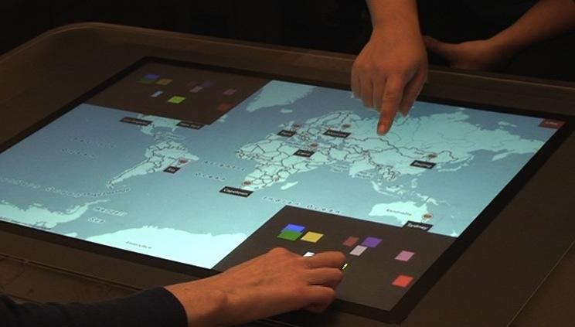


Access Overlays: Improving Non-Visual Access to Large Touch Screens for Blind Users
Shaun K Kane
University of Maryland
Baltimore County
Meredith Ringel Morris
Microsoft Research
Annuska Z Perkins
Microsoft
Daniel Wigdor
University of Toronto
Richard E Ladner
Jacob O Wobbrock
University of Washington
Notes:
Good morning. Thanks very much for coming. My name is Shaun Kane, and today I’m going to tell you about my research, which has largely focused on the challenges of understanding and creating, usable touch interactions for blind people

Slide 2
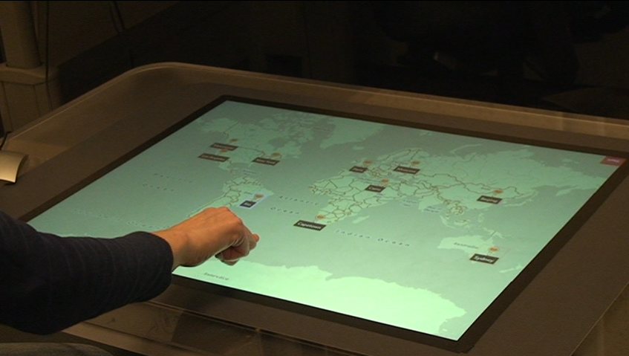
Access Overlays: new techniques to improve the accessibility of large touch screens
for blind and visually impaired people.

Slide 3
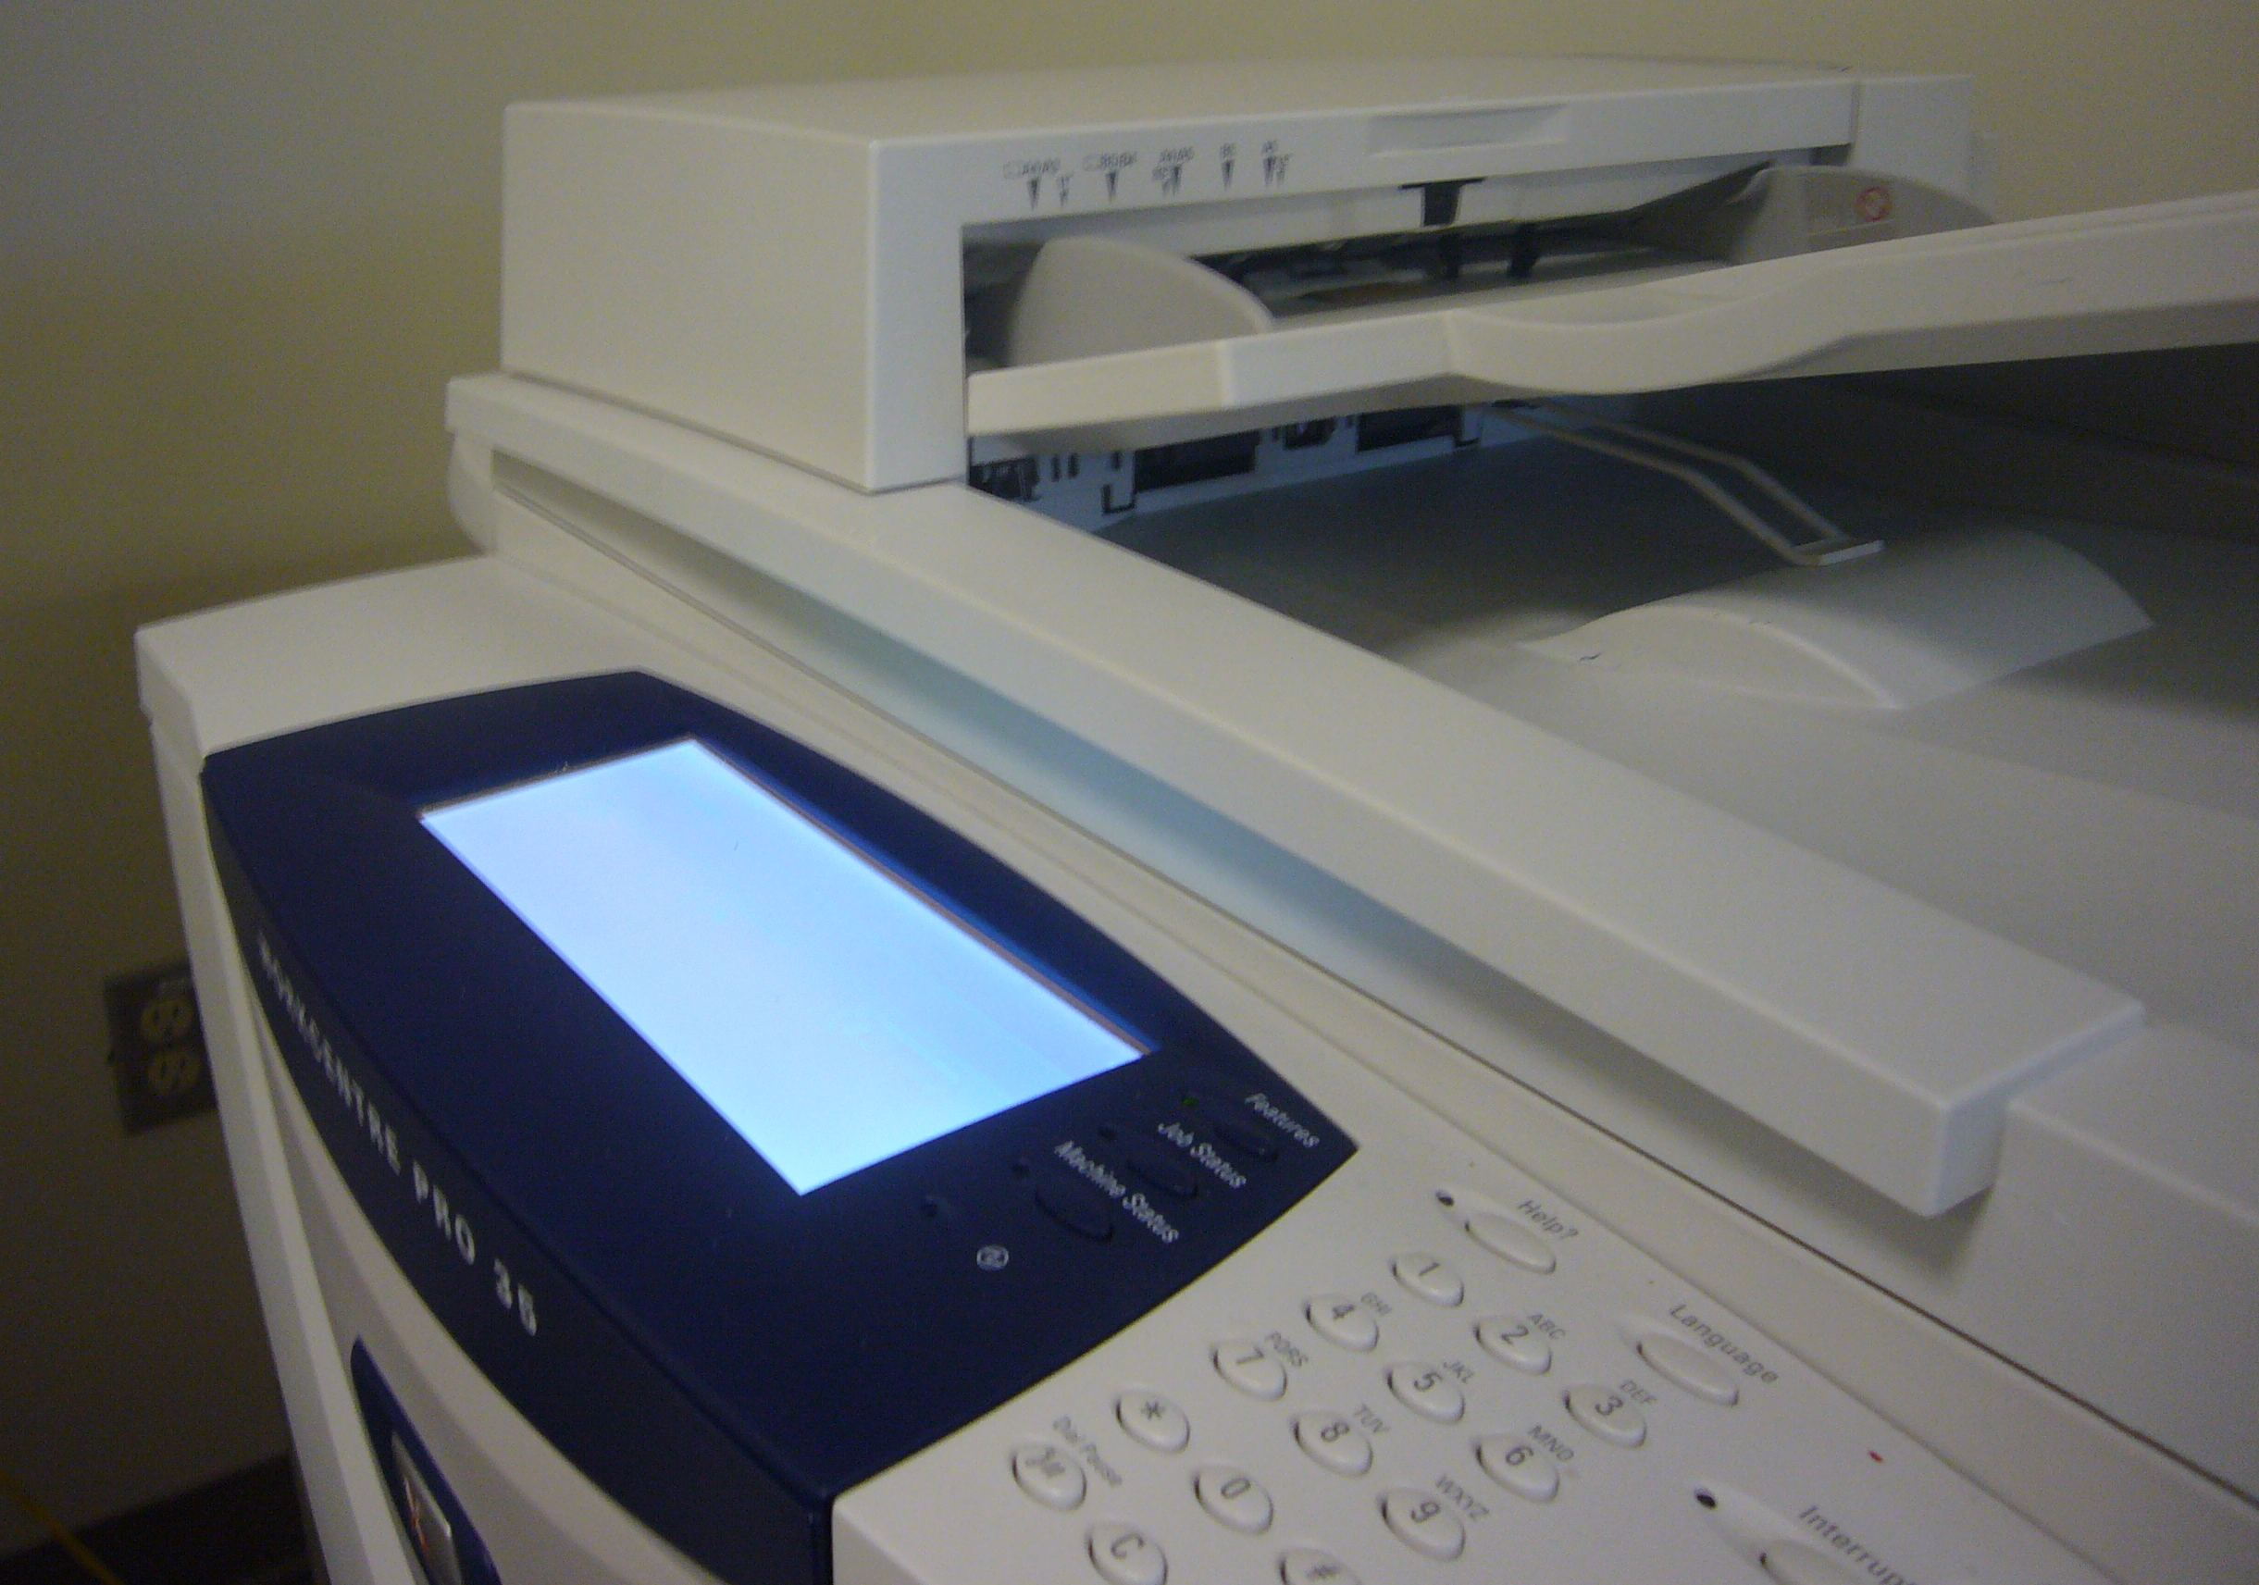
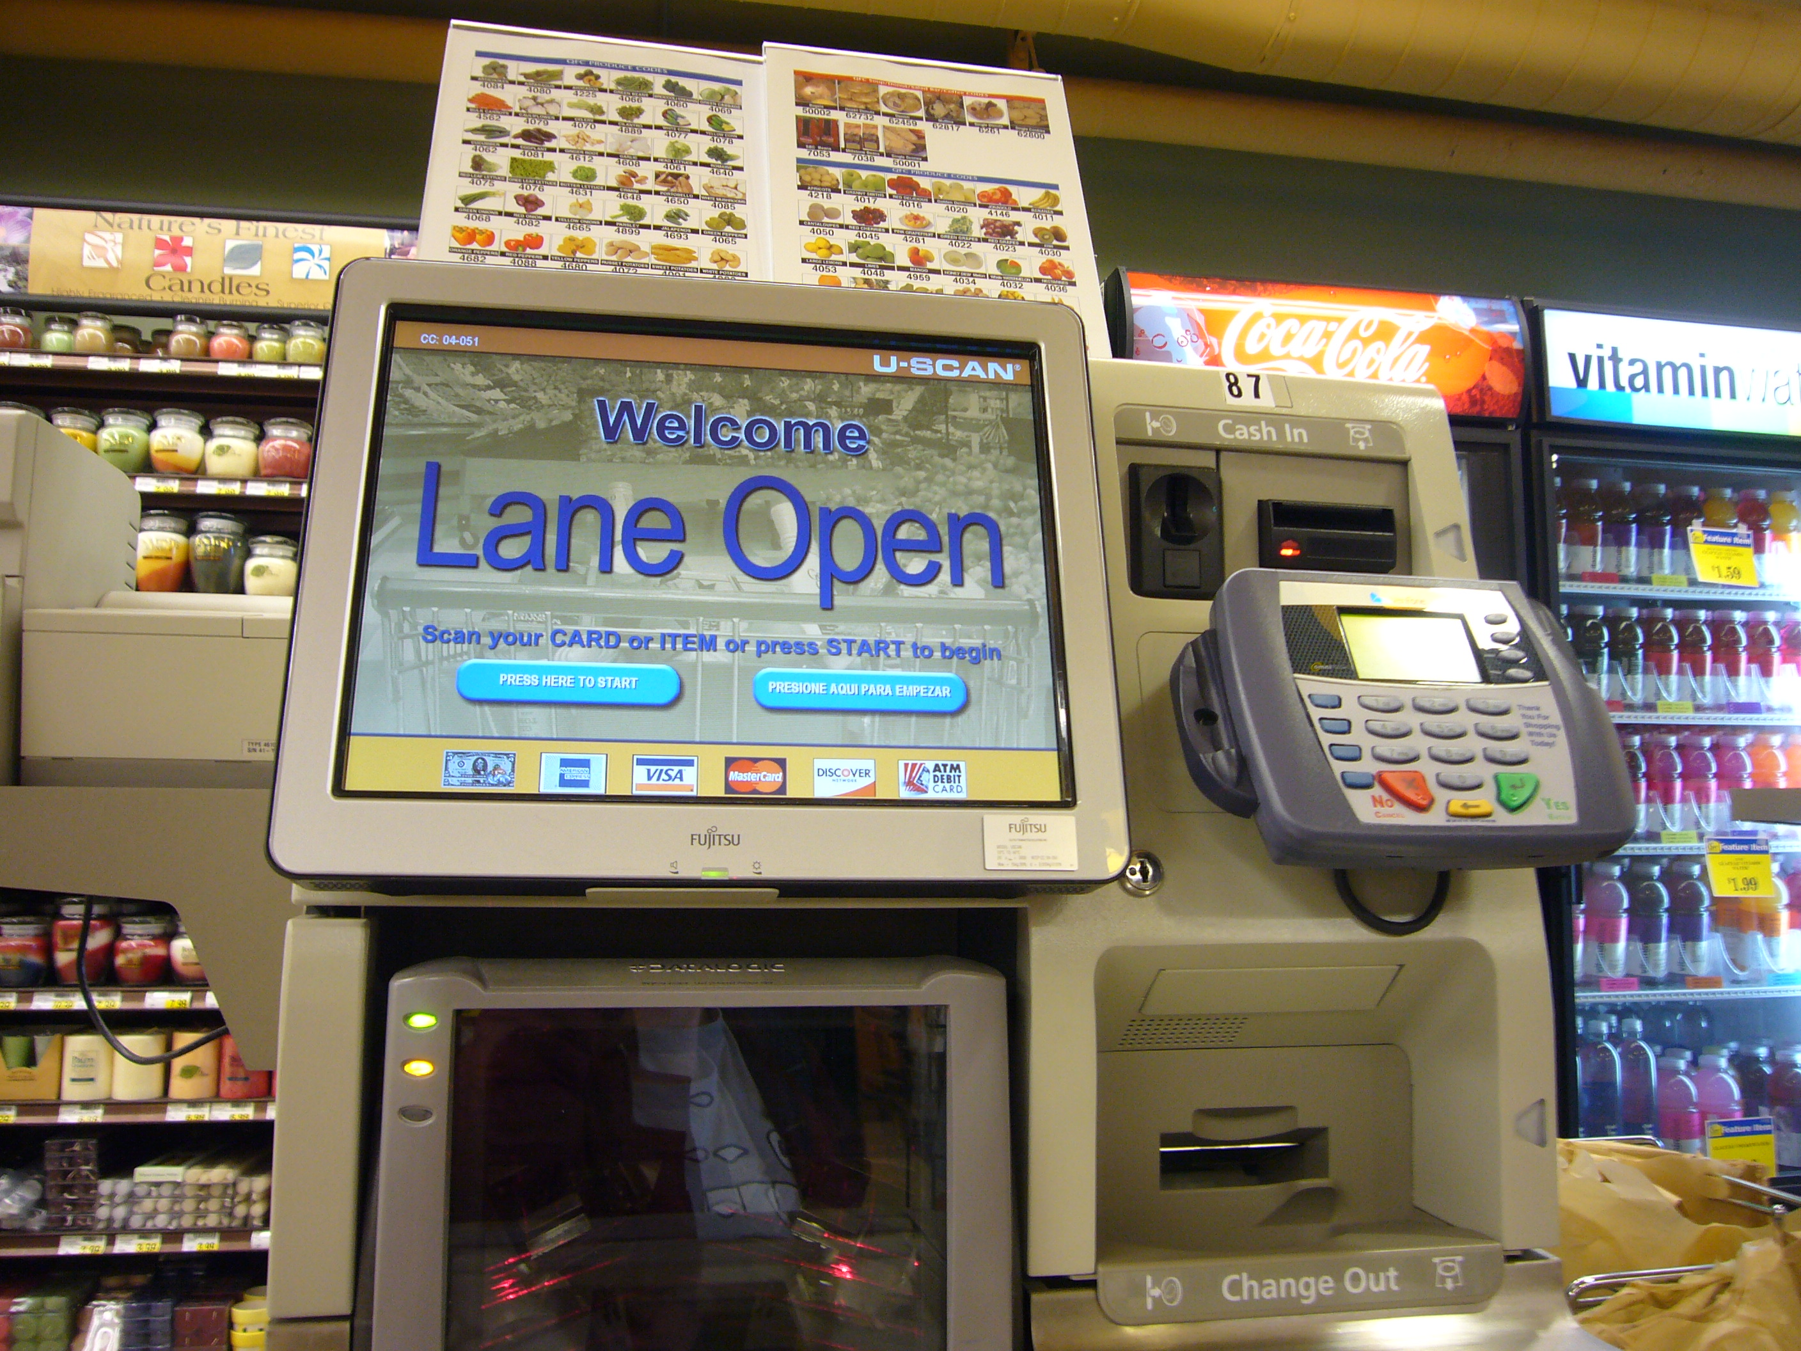
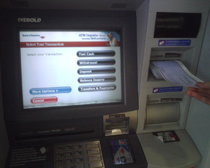
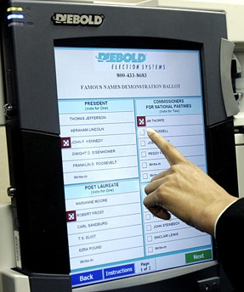
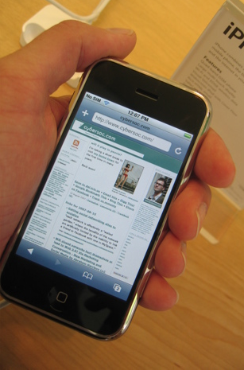

Slide 4
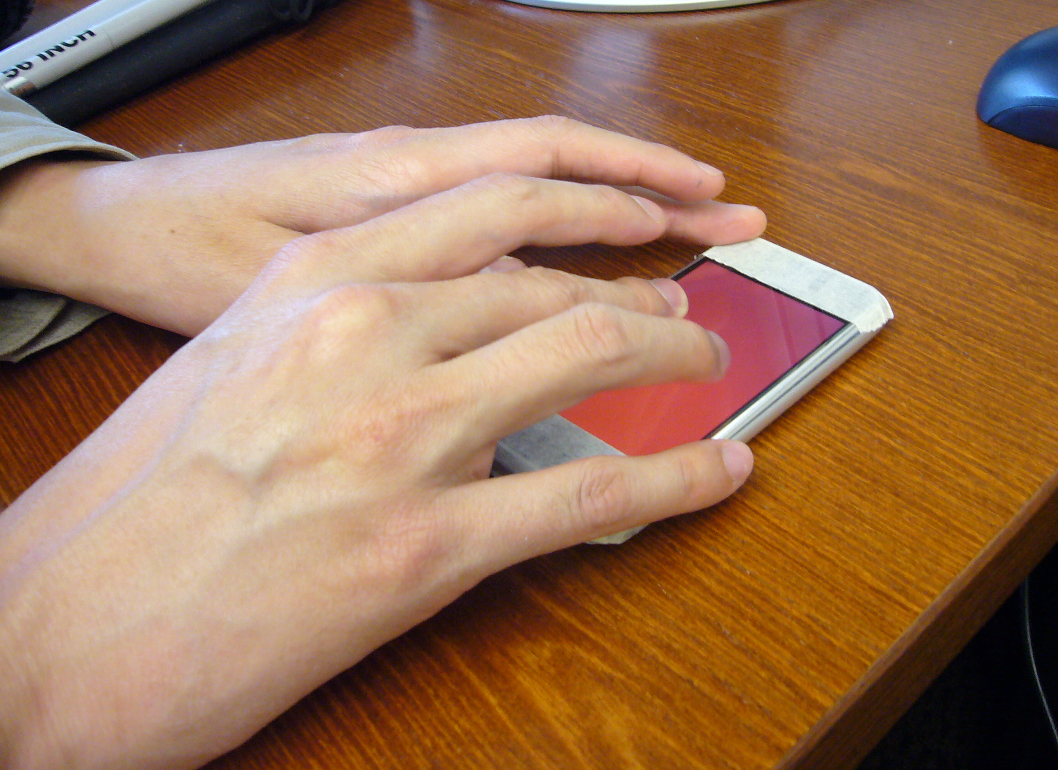
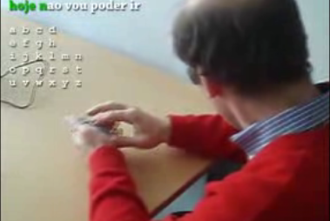
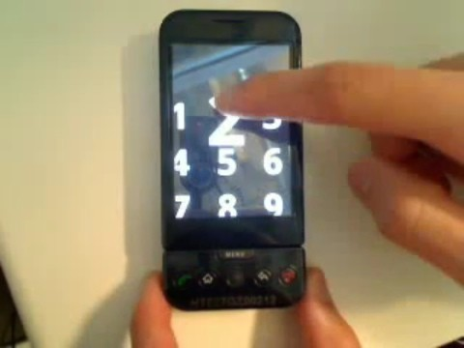
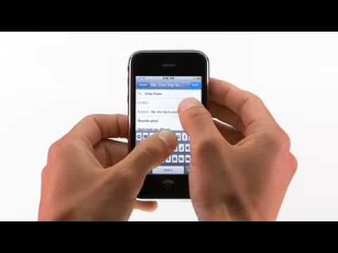
Accessible touch screens
Yfantidis and Evreinov ‘06
Sanchez and Aguayo ’07
Kane et al. ’08
Guerriero et al. ‘08
Bonner et al. ‘10
Kane et al. ‘11
Frey et al. ‘11
Xu et al. ‘11
…
Slide Rule (Kane et al., 2008)
NavTouch (Guerriero et al., 2008)
Eyes-Free Shell (Google, 2009)
VoiceOver for iPhone (Apple, 2009)

Slide 5
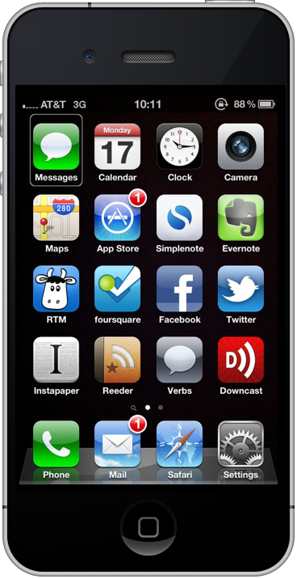
Making touch accessible
“Messages”
Gesture input + speech output
Gestures move cursor through a linear list of targets
Targets speak their name when selected
Alternative two-finger tap selection (Kane et al., 2008)
Notes:
Solve the problem of how to navigate the phone if z

Slide 6
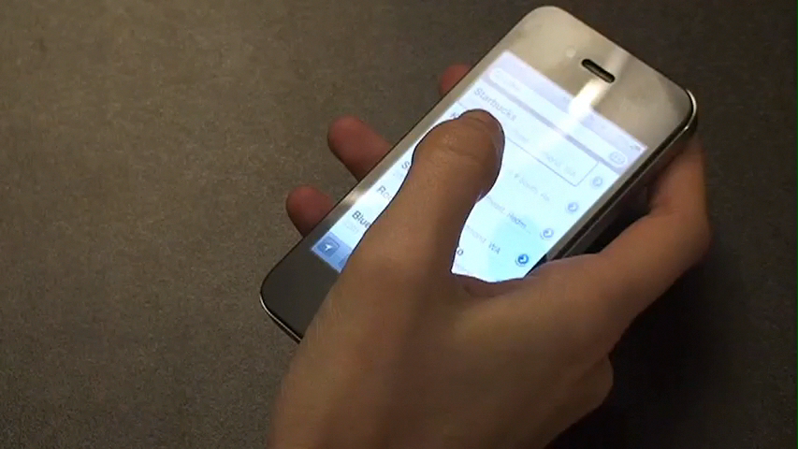

Slide 7
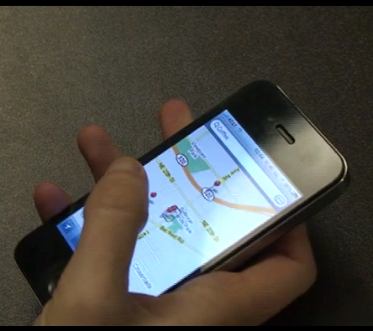
Limitations of current approaches
Linear list may reduce spatial understanding
Designed for phone-sized screens
May not be ideal for larger screens
7

Slide 8
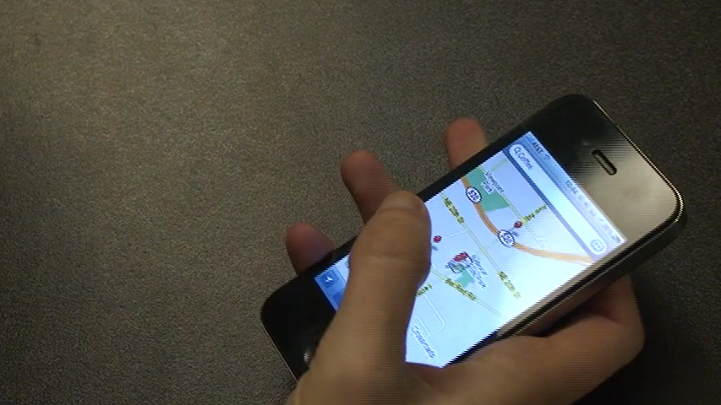

Slide 9
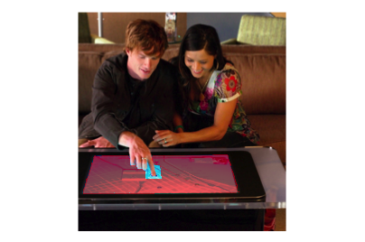
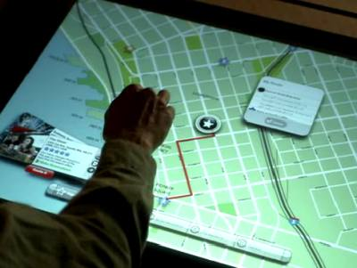
Access Overlays
Develop accessible gesture-based interactions for larger touch screens
Address challenges of working with large touch screens non-visually
  Finding items
  Navigating spatial layouts

Slide 10
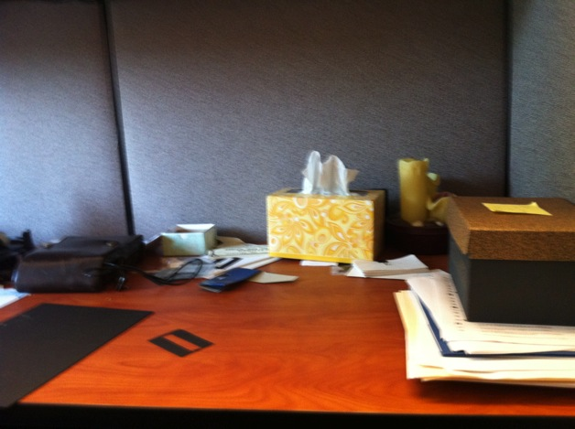
Interviewed 8 blind office workers about their organization and search strategies at work.
Notes:
-4m, 4f
Observed 8 blind people in their place of work (or home office)
Walkthrough of personal space
Discussed organization strategies, difficulties
Asked people to organize a shoebox full of vacation souvenirs

Slide 11
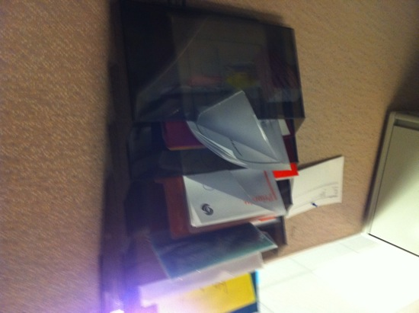
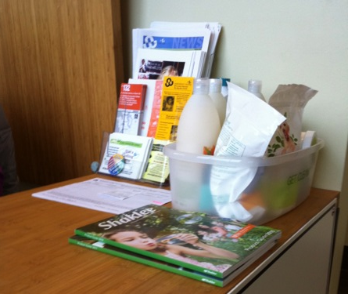
Findings
Participants relied on physical landmarks (edges, corners) as organizing structure
Participants remembered the approximate location of items, then searched locally
Search was easy if the approximate location is known, otherwise difficult
Notes:
-4m, 4f
Observed 8 blind people in their place of work (or home office)
Walkthrough of personal space
Discussed organization strategies, difficulties
Asked people to organize a shoebox full of vacation souvenirs

Slide 12
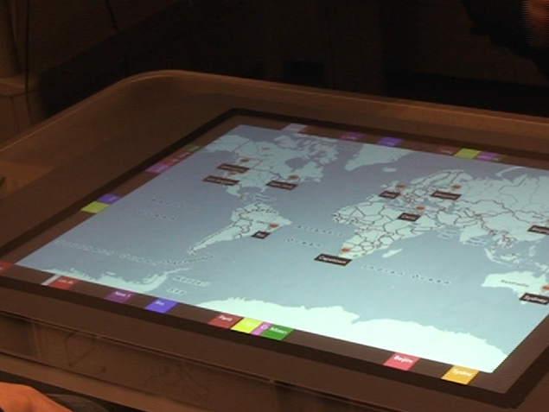
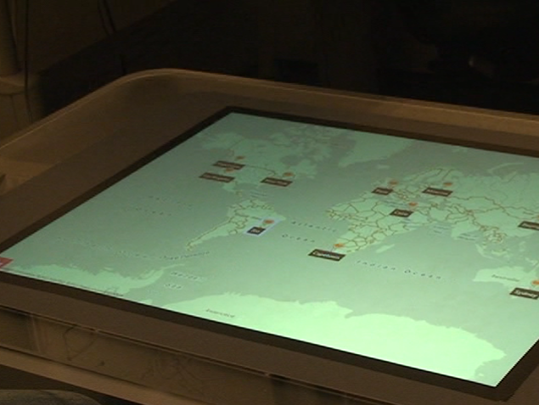
Access Overlays
Notes:
And to give you a brief example of these limitations. I’ll show you a video of

Slide 13
Access Overlays
Notes:
And to give you a brief example of these limitations. I’ll show you a video of

Slide 14
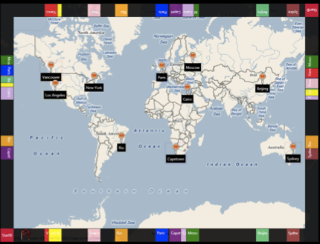
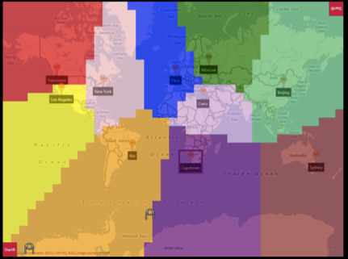
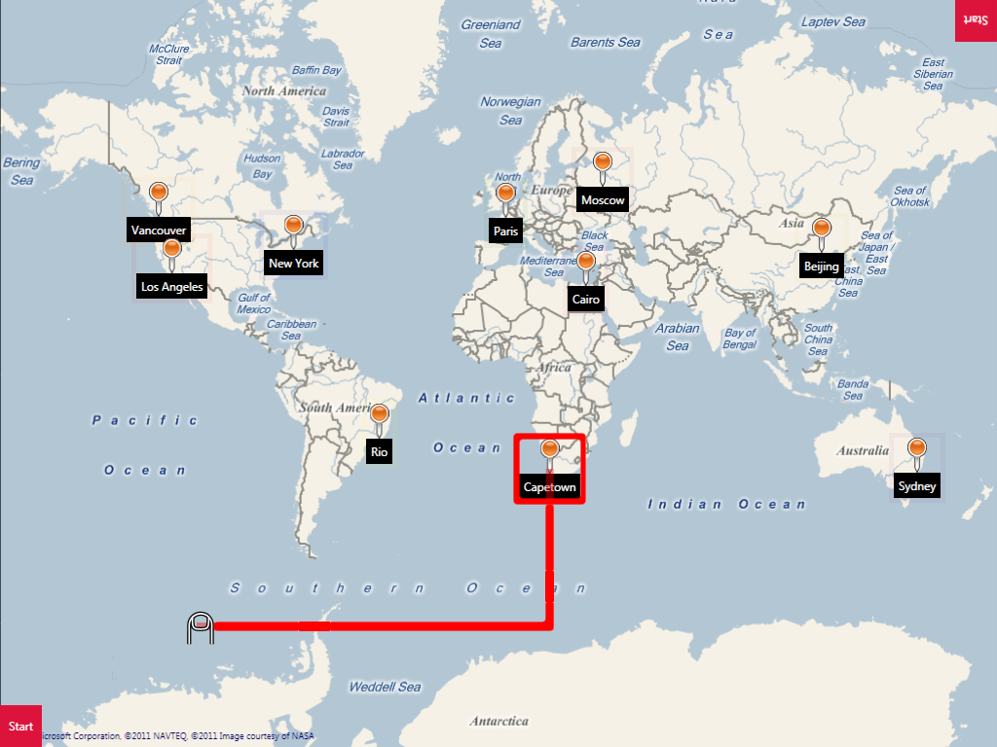
3 Access Overlays
Edge projection
Neighborhood browsing
Touch-and-Speak

Slide 15

Edge projection
Exploring a large screen with touch is time consuming
Project each on-screen target to the edge of the screen
User can read targets by touching only the edge
Use two hands to triangulate location

Slide 16
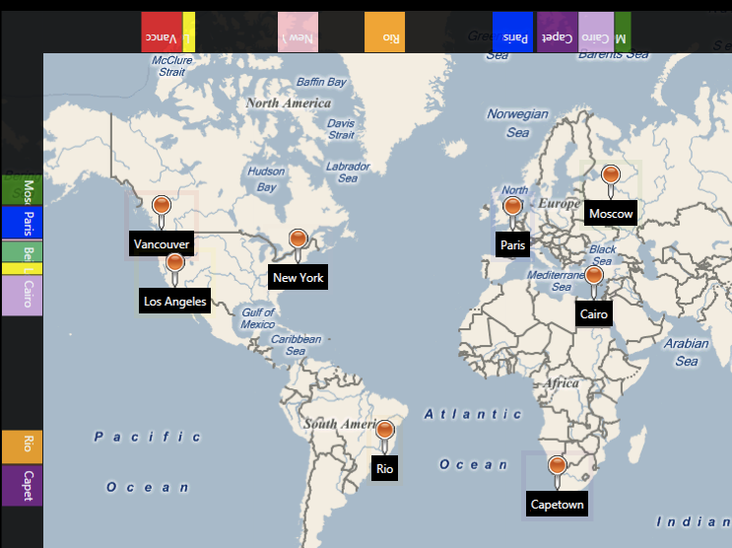

Slide 17


Slide 18
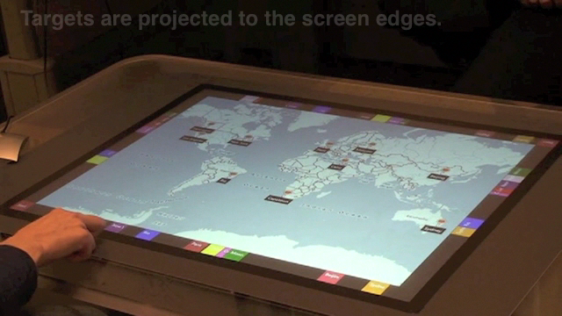
Notes:
These are demo videos using sighted users, and with screen on for illustrative purposes. Illustrative of tasks in the study I’ll describe.

Slide 19

Neighborhood browsing
Expands target hit area to fill entire screen using Voronoi tesselation
Touching near a target speaks its name and selects it, similar to Bubble Cursor (Grossman and Balakrishnan, 2005)
Search gesture provides guided speech feedback to target

Slide 21
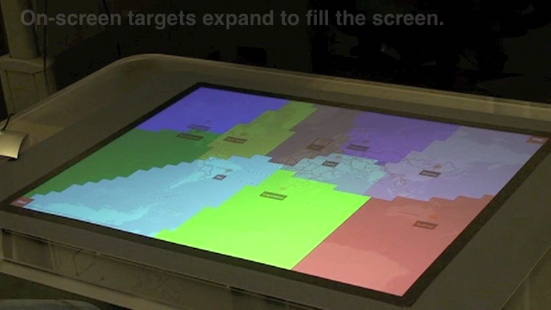

Slide 22
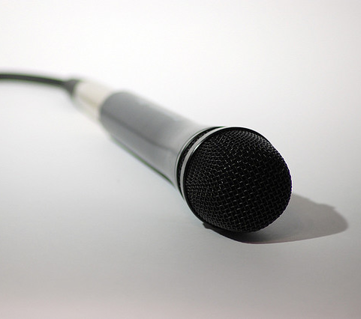
Touch-and-Speak
Use voice commands to list all targets on table, or nearby targets
Voice search to find known targets
Notes:
Browsing also

Slide 23
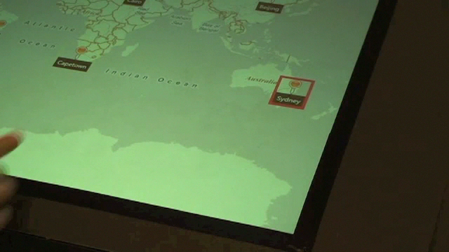

Slide 24
Evaluation
14 blind users (7m, 7f)
Compared 3 access overlays to VoiceOver using a map application on Microsoft Surface
Tasks comprised searching a map and answering questions about it
  How many cafés are on the map?
  Is the café to the east or west of the hotel?
  At what time does the bar open?

Slide 25
Results
Task completion time
Correctness & spatial understanding
User preferences

Slide 26
Completion time (in seconds)
Touch-and-speak faster than VoiceOver and neighborhood browsing (p<.01)
Edge projection faster than VoiceOver and neighborhood browsing (p<.01)

Slide 27
Correct answers
All access overlays had significantly higher correctness over VoiceOver (p<.01)

Slide 28
Preferred technique
Touch-and-speak and edge projection ranked significantly better than VoiceOver (p<.05)

Slide 29
Overview of results
2 of 3 access overlays were faster than VoiceOver
All access overlays resulted in more correct answers
Access overlays were subjectively rated better than VoiceOver

Slide 30
Comparing access overlays
Touch-and-speak and edge projection were fastest
Touch-and-speak was preferred (with caveats)
No clear winner: participants desired the ability to switch between overlays

Slide 31
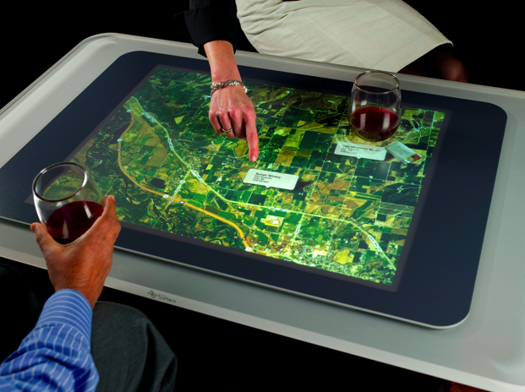
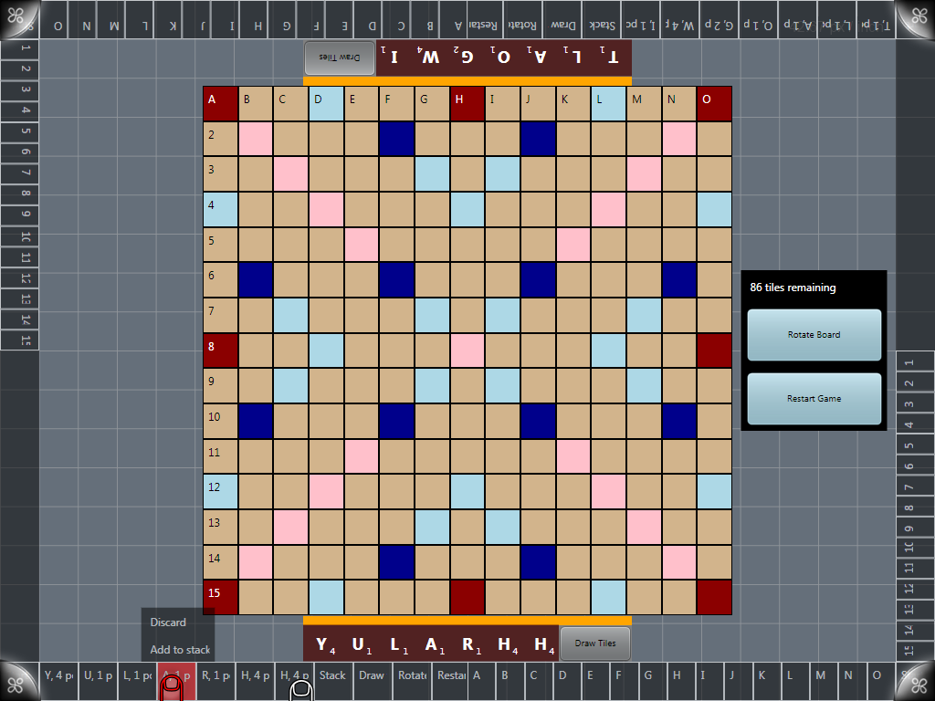
Future work
Taking advantage of additional hardware capabilities
Further support for collaboration
Application support
and API

Slide 32
Summary
Introduced access overlays,
enhanced exploration techniques for eyes-free use
of large touch screens
Access overlays can improve performance and spatial understanding

Slide 33
Thanks
Shaun K Kane
skane@umbc.edu
umbc.edu/people/skane
with Meredith Ringel Morris, Annuska Z Perkins,
Daniel Wigdor,
Richard E Ladner,
and Jacob O Wobbrock
Thanks to Microsoft Research and the Seattle Lighthouse for the Blind.
Notes:
1.3 million blind people in the US

Slide 35
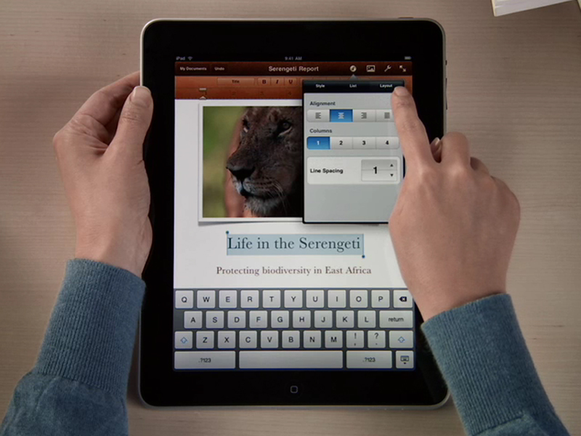
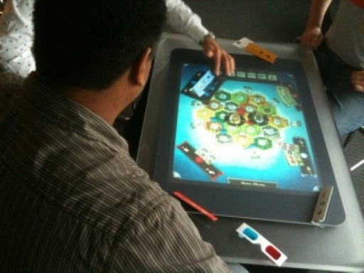
Three trends
Larger form factors
(tablets, tabletops)
More complex applications
Spatial layouts important

Slide 36
Experimental tasks focused on understanding spatial relations
  Find (where is Cairo on the map?)
  Browse (how many cities are on the map?)
  Relate (is Cairo to the east or west of Paris?)
  Refind (having found Cairo once; find it again)
  Select (move cursor to object)

Slide 38
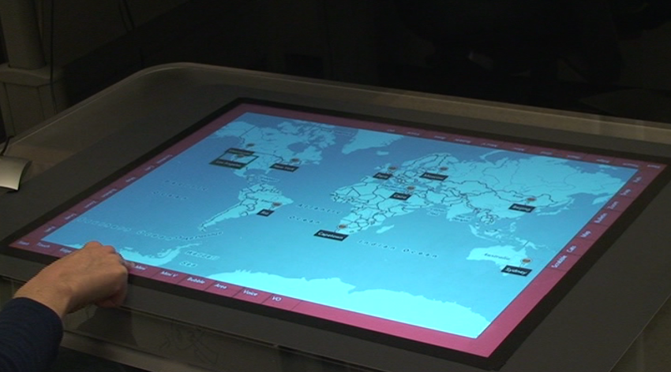
Applications
World map
Board games
API for adding overlay support to touch apps

Slide 39
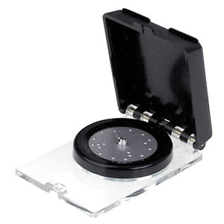
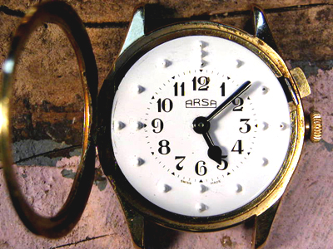
Limitations
Optimized for single user
Non-moving interfaces

Slide 40
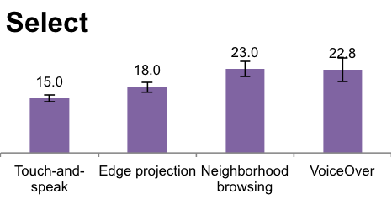
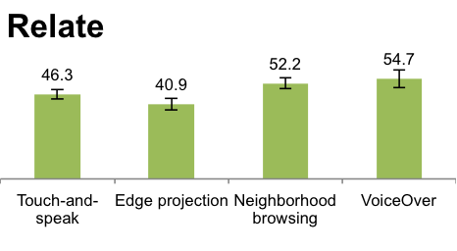
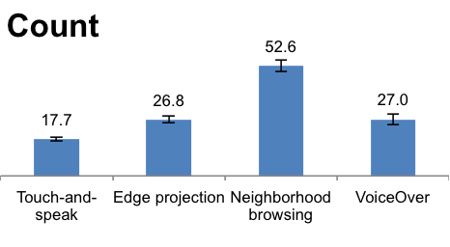
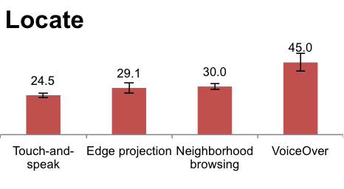
Completion time (by task)

Slide 41
VoiceOver
Implemented VoiceOver gestures on Microsoft Surface
  Use directional swipes to browse through items on screen
  Can also directly touch the screen to browse

Slide 42
Exploring a large surface
Large space makes search more difficult
Location and spatial layout important
  Maps, games
Current techniques (e.g., VoiceOver) support browsing lists, but do not provide much spatial information
Can we do better?

Slide 43
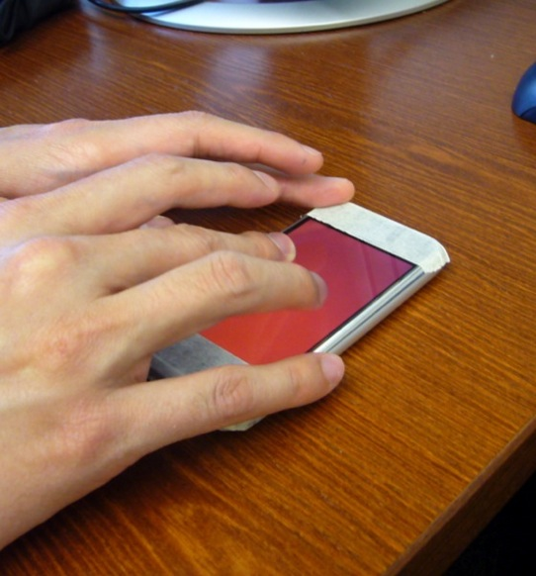
Slide Rule
How can existing touch screen-based mobile devices be redesigned to support the abilities of blind people?
Developed a prototype with accessible multi-touch interaction techniques
Kane, S.K., Bigham, J.P. and Wobbrock, J.O. (2008). Slide Rule: Making mobile touch screens accessible to blind people using multi-touch interaction techniques. Proceedings of ASSETS ’08.
Related work: Vanderheiden 1996; Wells and Landau 2003; Yfantidis and Evreinov 2006; Sanchez and Aguayo 2007; Guerriero et al. 2008
Notes:
The first project is called Slide Rule. It began with the question: how can we take an existing touch screen based mobile device, which is not accessible, and redesign the fundamental interactions that it supports
And to give you some context about this project, although we did see accessibility on the iPhone in the video. This project, Slide Rule, predates that work. At the time this work began, most commercially available touch screen devices provided no accessibility support, and those that did were quite limited.

Slide 44
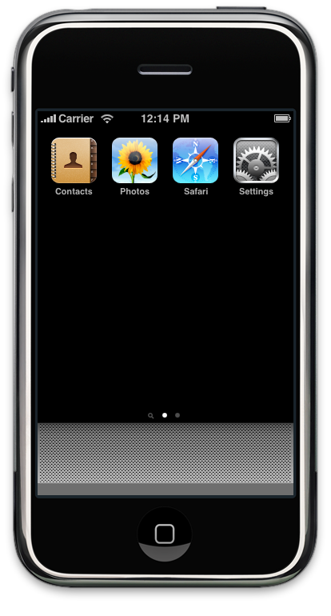
Redesigning the touch interface
Notes:
I’ll show you a demo video in just a moment. Before I do that, I’ll walk you through a few of the design insights that form the basis of Slide Rule
And I’ll begin by looking at a common touch screen interface for sighted people. In this case the iPhone.

Slide 45
Hunting and pecking for icons
Notes:
Only a few icons on screen in this case, and contained in a relatively small area

Slide 46
Hunting and pecking for icons
Unused screen space
Notes:
Related to this, quite a bit of unused screen space. Currently dead space. If a user touches here, nothing happens.

Slide 47
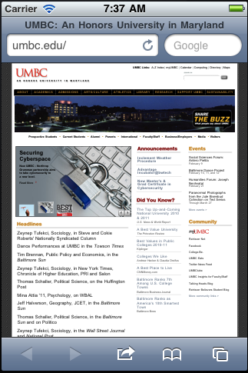
Hunting and pecking for icons
Unused screen space
Accidental activation
Notes:
And finally, an issue that appeared in the prior study, which is: even if the user can hear what’s on the screen, there’s still the issue of how they explore around without changing anything. So s

Slide 48
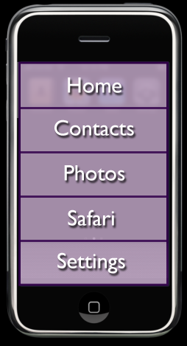
Slide Rule
Overlay screen with large buttons in a row
Notes:
This increases button size and removes the dead space

Slide 49
Slide Rule
Overlay screen with large buttons in a row
Buttons say their name when touched

Slide 50
Slide Rule
Overlay screen with large buttons in a row
Buttons say their name when touched
To select an item, tap anywhere on the screen with a second finger

Slide 51
Benefits
Risk-free exploration
Safe, reliable selection

Slide 52
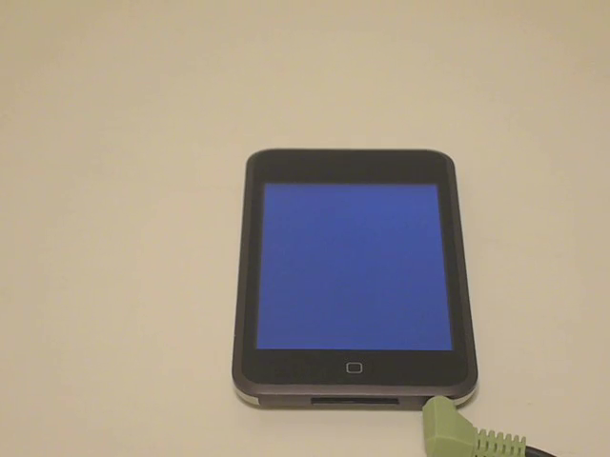
Notes:
2 comments before I start. No visual display. Second, a lot of details here. To show you how these details come together.

Slide 53
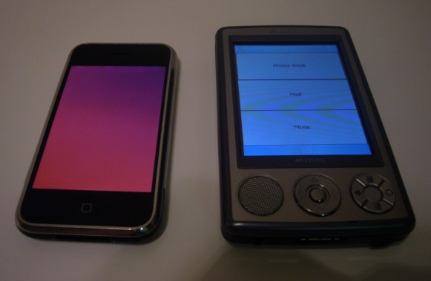
Evaluation
Compared Slide Rule to a
Pocket PC with a 4-way
directional control
10 blind computer users
(8m, 2f)
3 tasks using identical applications:
Selecting addresses, reading e-mail messages,
controlling music player
Notes:
You’ve seen a demonstration of some of the things that can be done with an accessible touch screen. But I want to also show you that it does work.

Slide 54
Summary of results
7 out of 10 participants preferred Slide Rule
  “I’ve never seen a touch screen that accessible before, and that was pretty cool.”
Slide Rule was faster than the Pocket PC (p<.05)
However, Slide Rule was more error prone (p<.05)
Notes:
Even though the

Slide 55
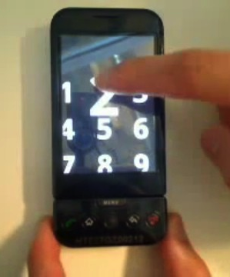
Adoption
Not technically feasible to deploy Slide Rule
Following Slide Rule, similar systems adopted by Apple and Google
VoiceOver for iPhone
(Apple, 2009)
Android Eyes-Free Shell
(Google, 2009)
Notes:
Due to technical constraints it was impossible for us to release these tools in a way that they could be used
Personal communication that this work was known and influenced the design

Slide 56
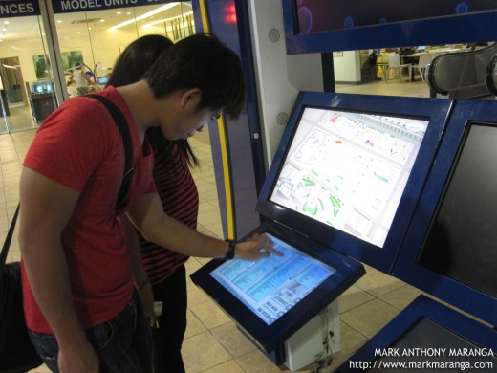
Navigation techniques for large touch screens
Current touch screen access techniques optimized for phone-sized devices
Larger touch screens are becoming more common
How do we scale these
techniques to larger
devices?

Slide 57
Exploring a large surface
Large space makes search more difficult
Location and spatial layout important
  Maps, games
Current techniques (e.g., VoiceOver) support browsing lists, but do not provide much spatial information

Slide 58
Access Map
Combines localization techniques with search and filtering
To be presented at 2011 International Technology & Persons with Disabilities Conference (CSUN ‘11)
Notes:
Our hope here is to provide reusable, generalizable techniques for accessing large surface applications

